Slide 1

Update in Lipid Managment
Dr. Mohamed Abu-Farha

Slide 2
CVD Public Health Significance
Leading cause of mortality in developed countries and a rising tendency in developing countries
A major impact on life expectancy
Significantly contributes to morbidity and death rates in the middle aged population: potential life years lost, common cause of premature death, labor force (economic costs), family life
Morbidity: nearly 30% of all disability cases
Contributes to deterioration of the quality of life
Notes:
CVD is the leading global cause of death. What is important is that it is not inevitable that we need to die from CVD (Supercourse)

Slide 3
Cardiovascular Disease: A Global Challenge
Leading Cause of Global Mortality
In 2022 19.8 million deaths worldwide leading to 44.9 million years lived with disability (YLD)
Premature Deaths: 34% of CVD deaths occur before age 70
Amenable to prevention or treatment with effective interventions
Victoria Declaration (1992):
“We have the scientific knowledge to create a world in which heart disease and stroke are rare.”
Millions still succumb prematurely despite available solutions.

Slide 4
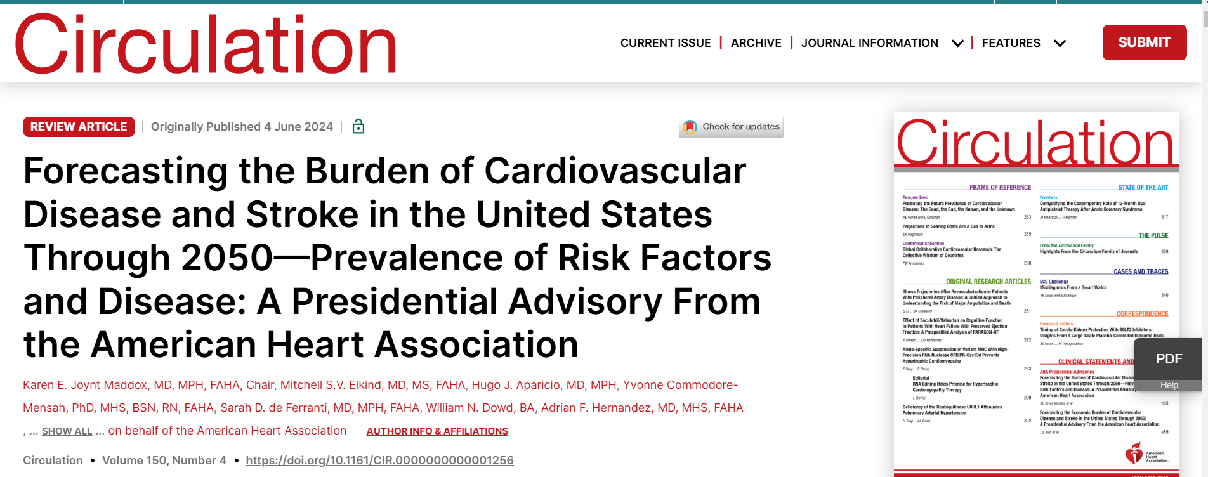
The prevalence of many cardiovascular risk factors and cardiovascular and cerebrovascular diseases will increase markedly over the next 30 years

Slide 5
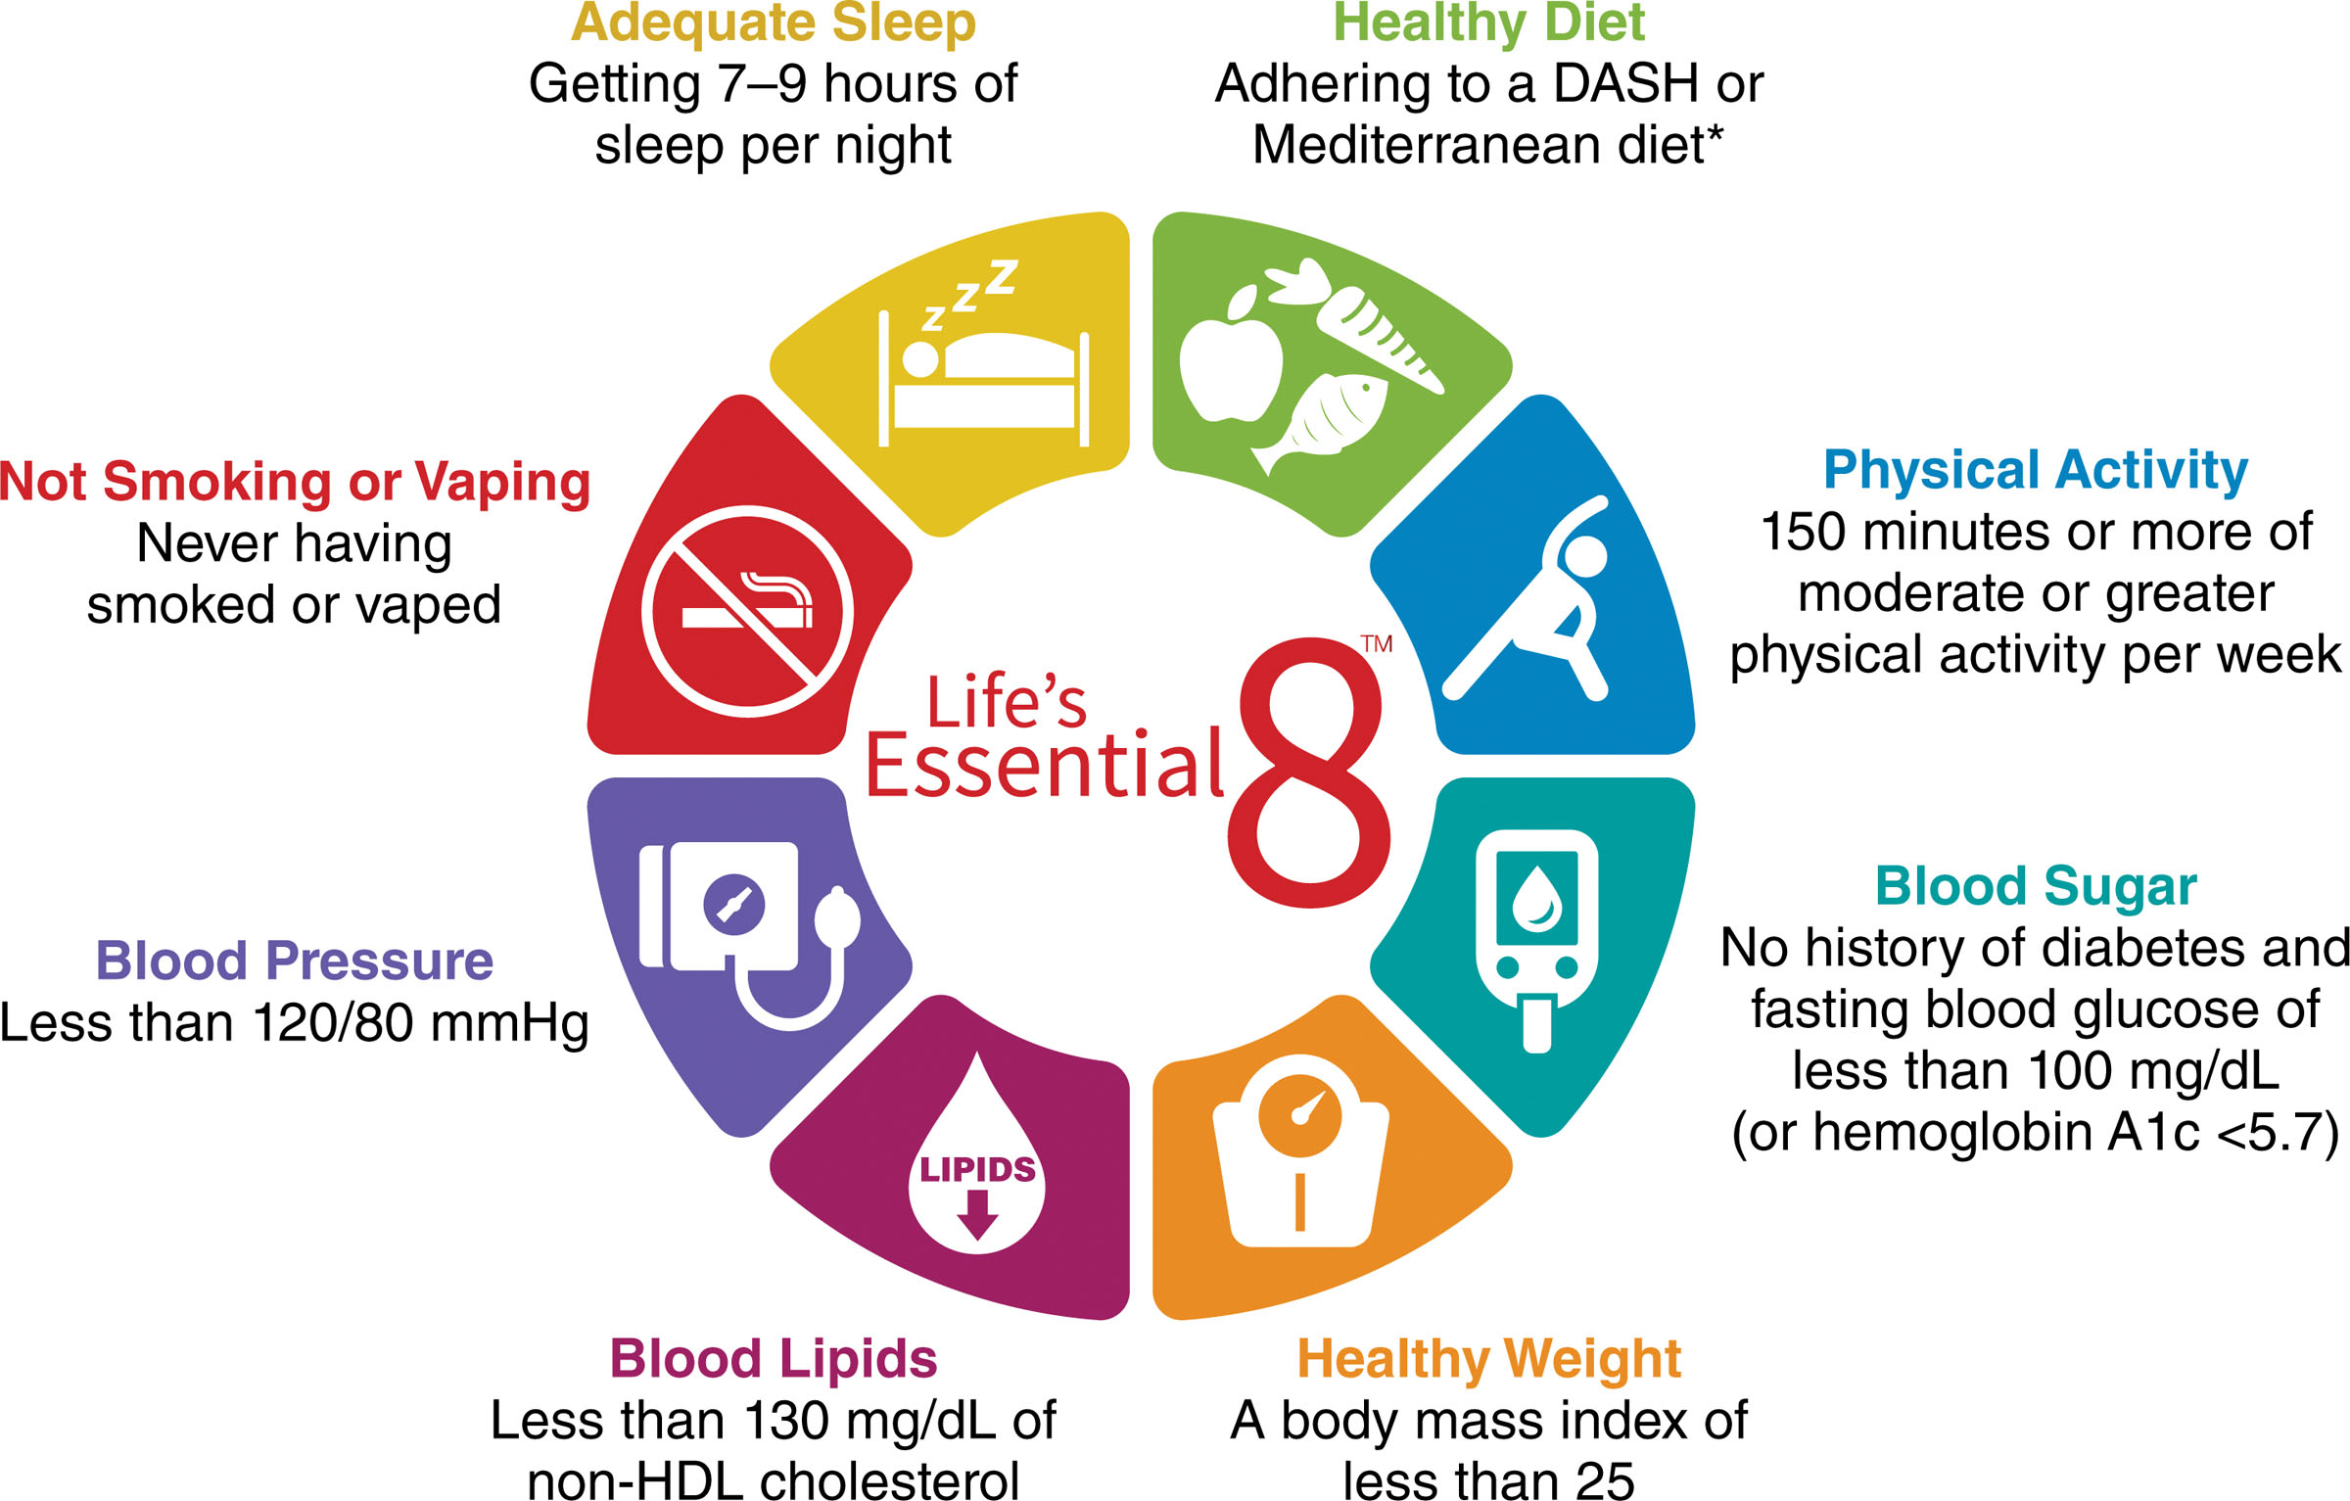
Life’s Essential 8 are the key measures for improving and maintaining cardiovascular health

Slide 6
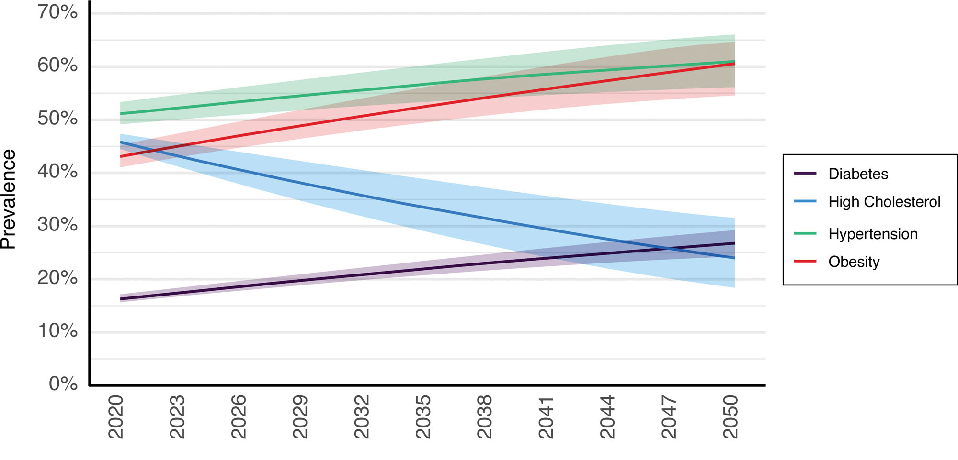
The prevalence of many cardiovascular risk factors and most established diseases will increase over the next 30 years.
hypertension will increase from 51.2% in 2020 to 61.0% in 2050. Larger increases were projected for diabetes (16.3% to 26.8%) and obesity (43.1% to 60.6%). However, there was a continued projected decline in hypercholesterolemia (45.8% to 24.0%).

Slide 7
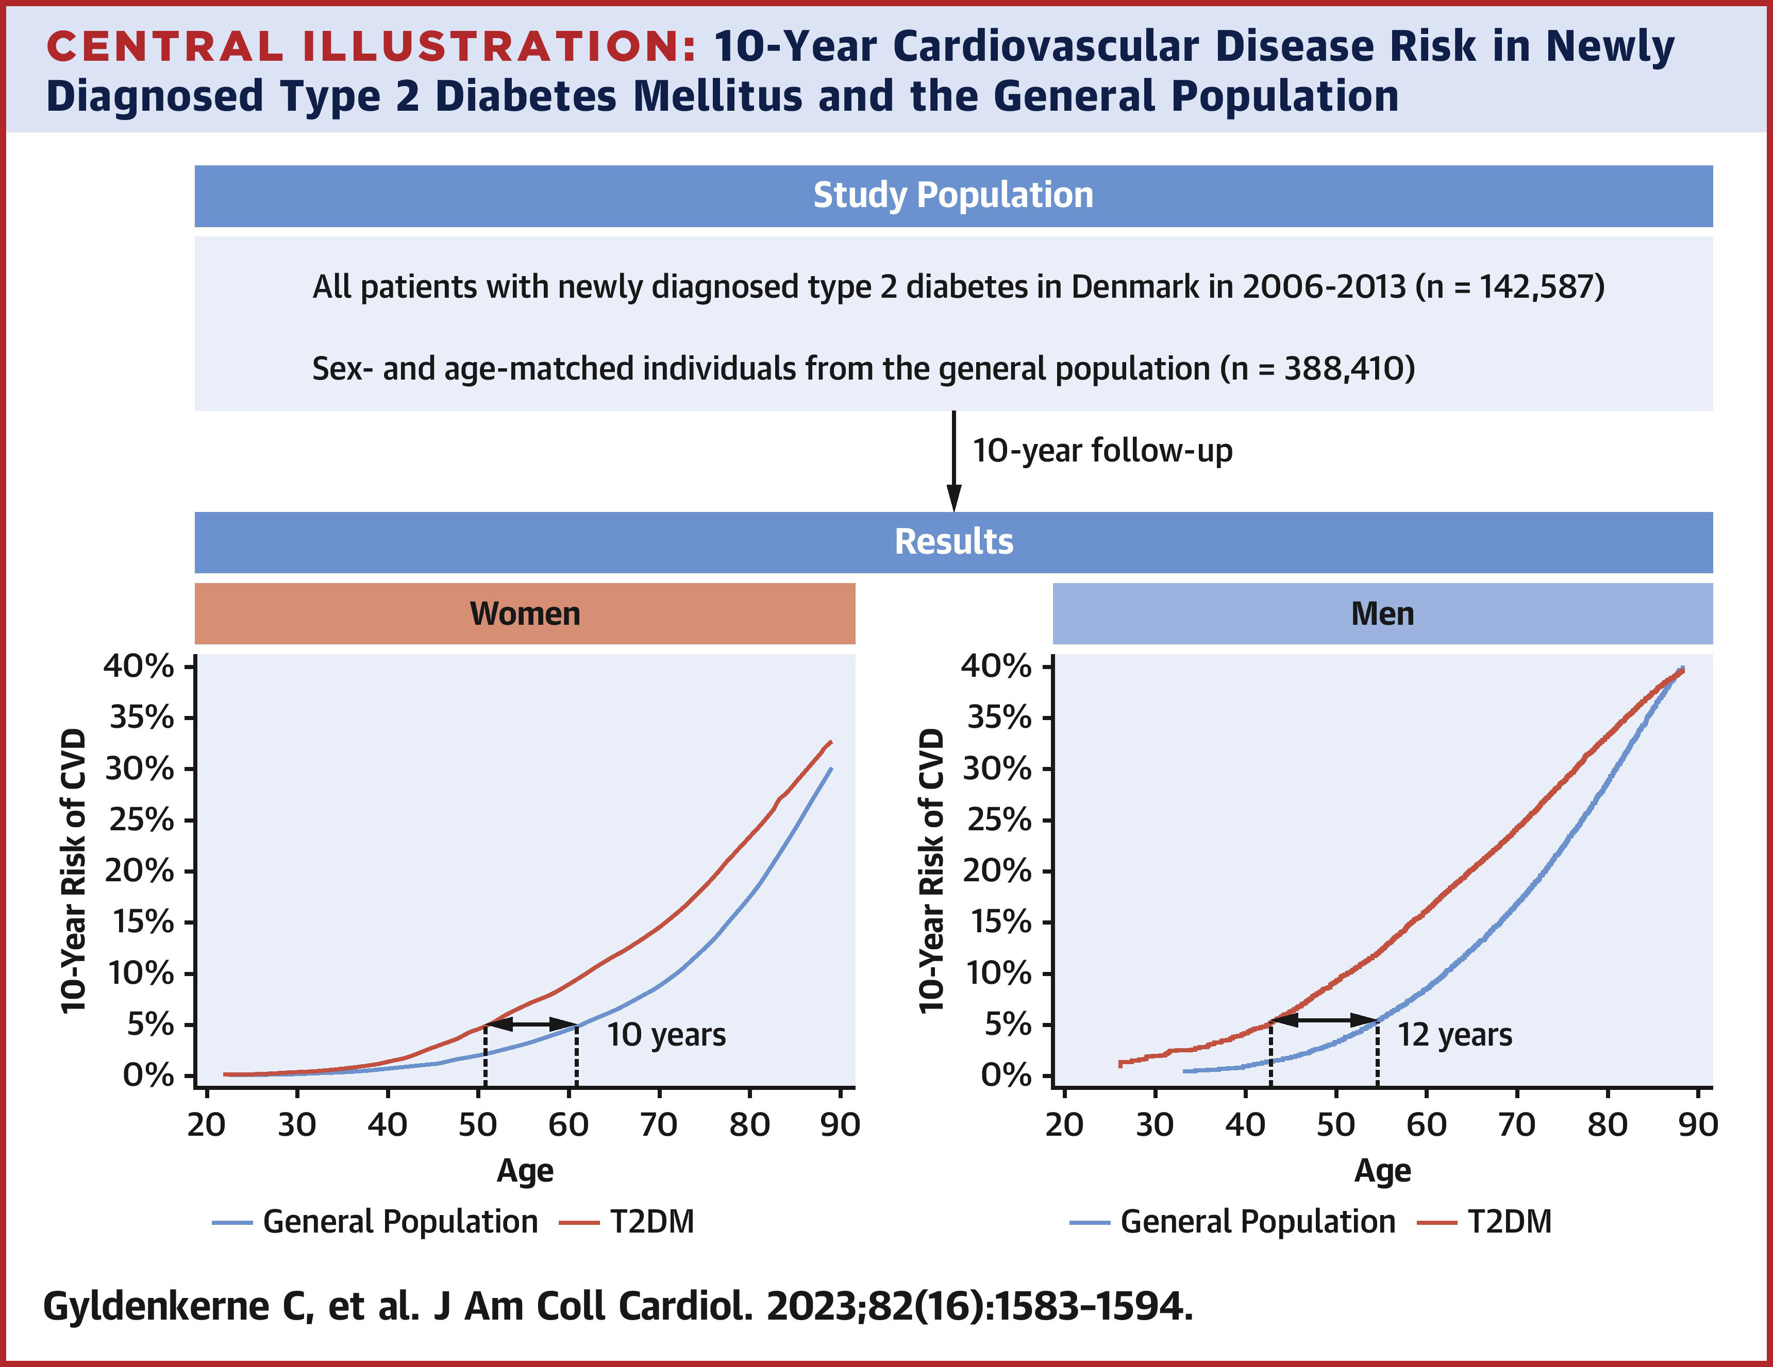
Newly diagnosed T2DM increased 10-year CVD risk across both sexes and all age groups, especially among younger patients, with CVD occurring ≤12 years earlier than in general population individuals.

Slide 8
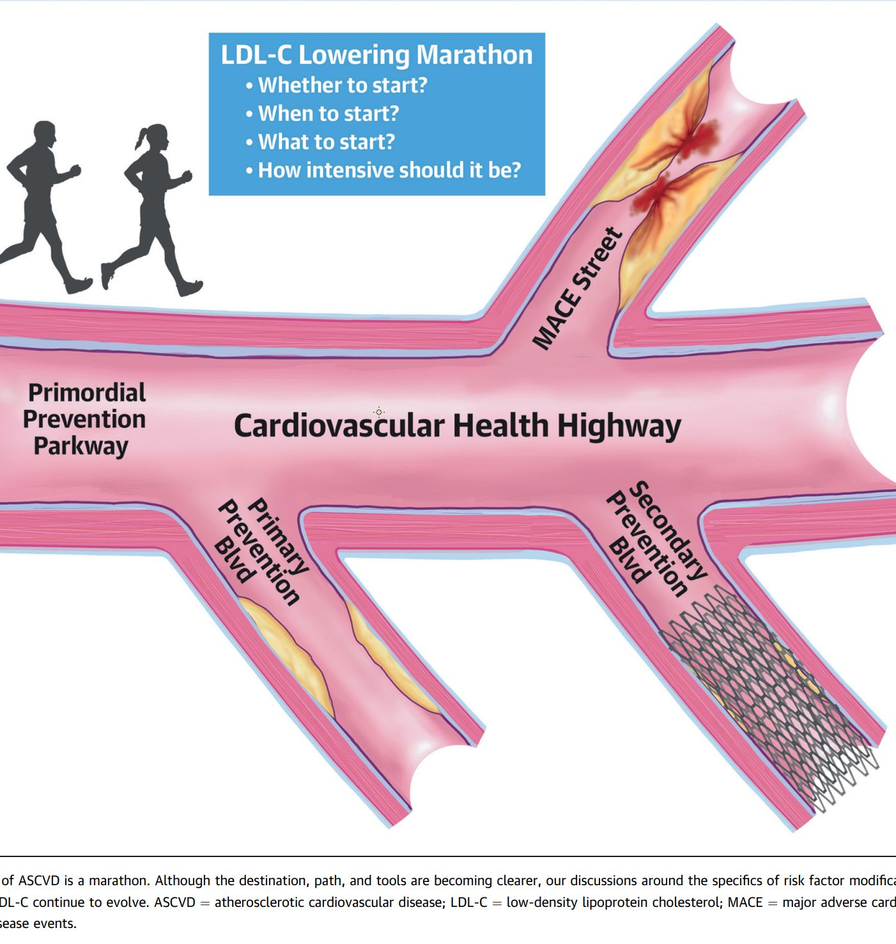
LDL Lowering Therapies
Nambi and Abushamat, Journal of the American College of Cardiology, Volume 83, Issue 6, 2024, Pages 665-668,

Slide 9
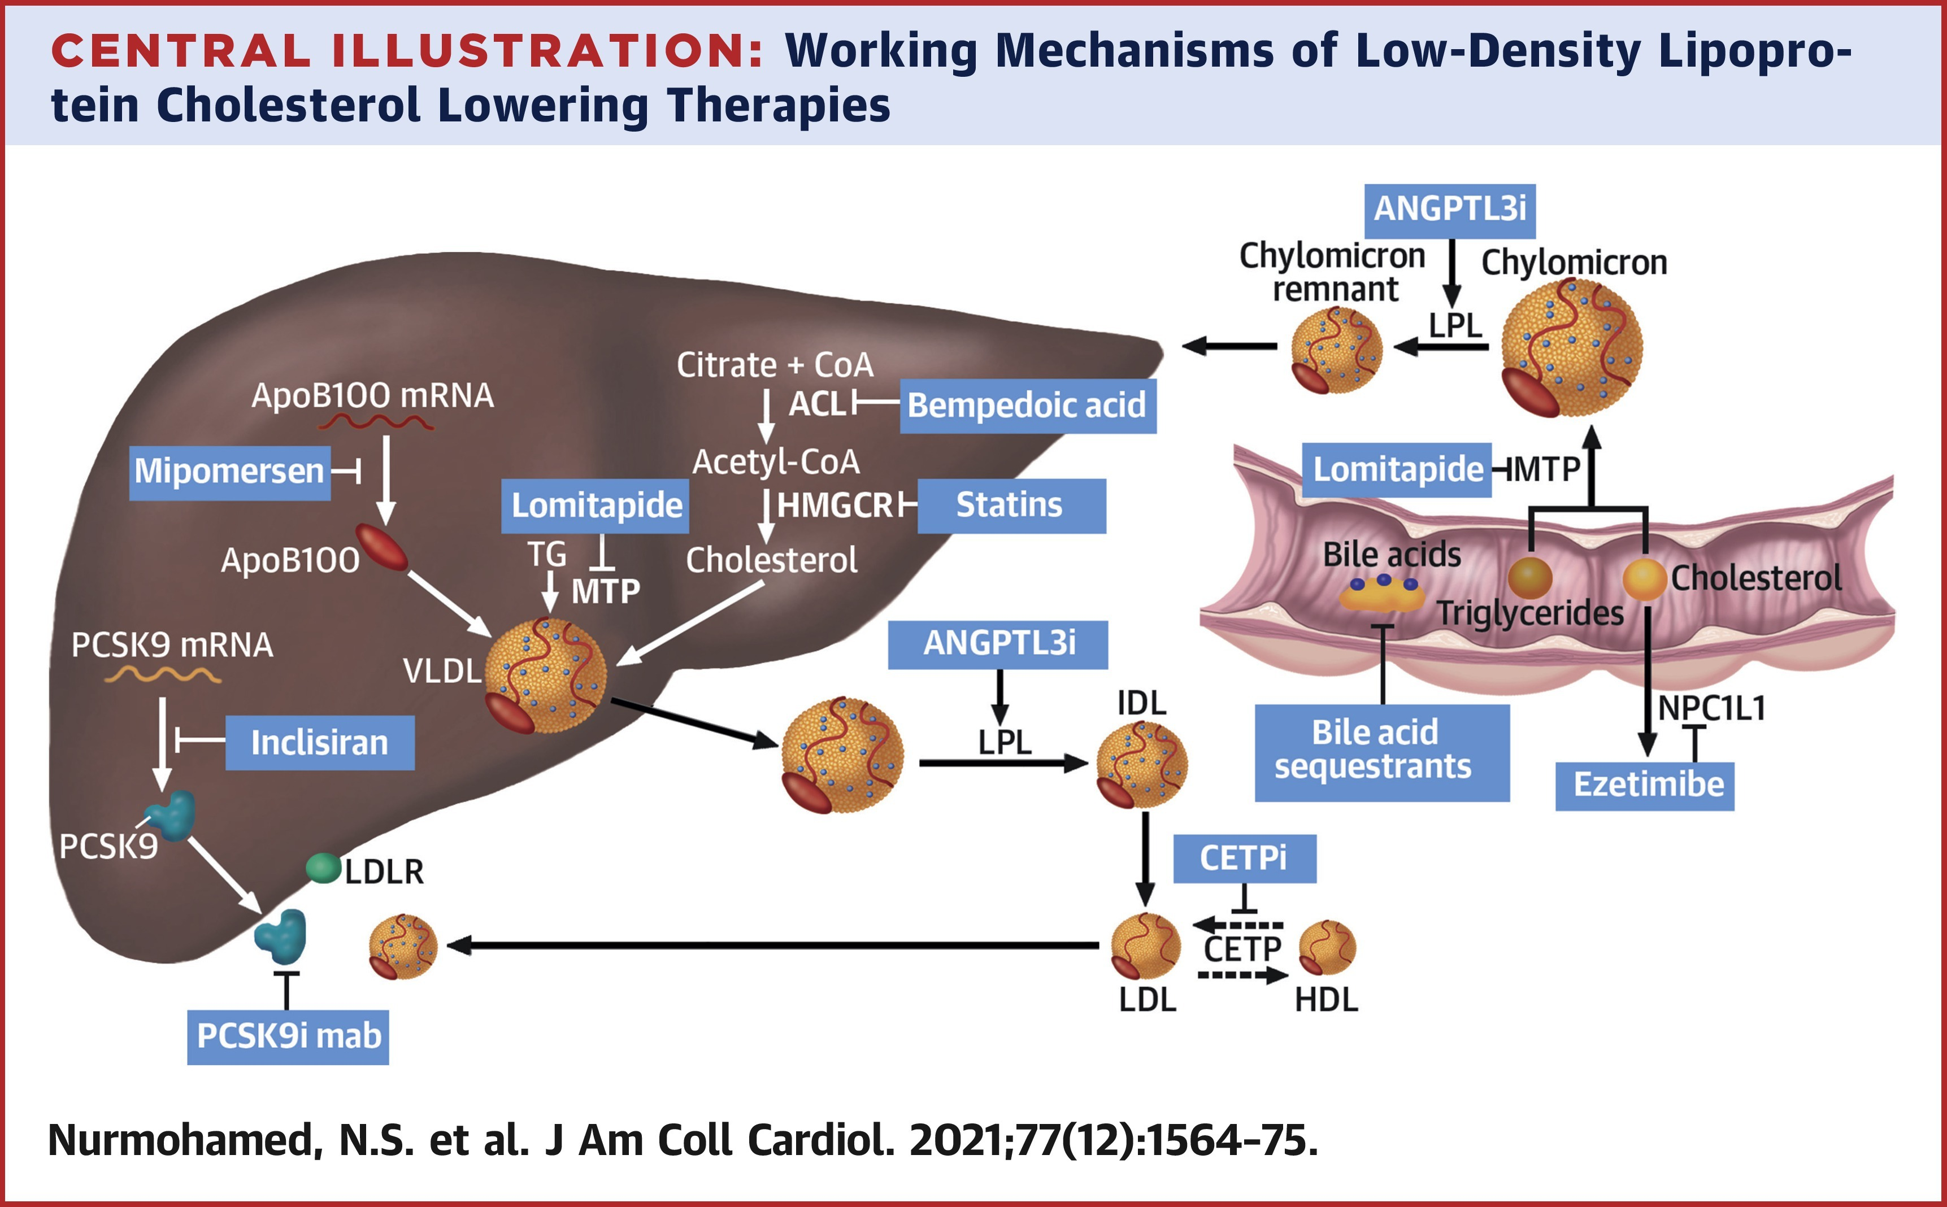

Slide 10
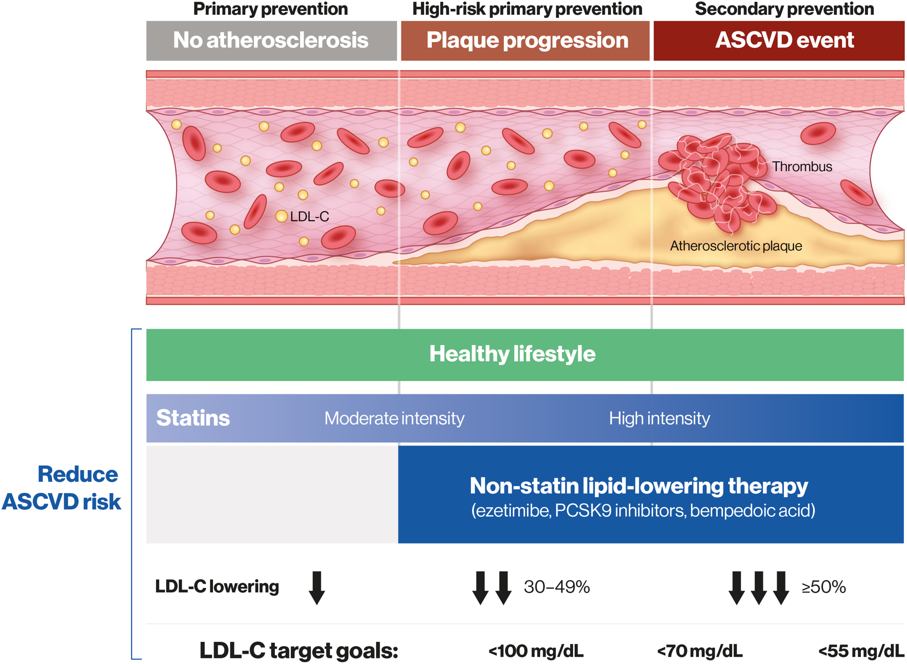
The continuum of atherosclerotic cardiovascular disease (ASCVD) risk
Notes:
Management of low‐density lipoprotein cholesterol (LDL‐C) levels across the continuum of ASCVD risk to prevent first and subsequent cardiovascular events. PCSK9 indicates proprotein convertase subtilisin/kexin type 9.
Open in viewer

Slide 11
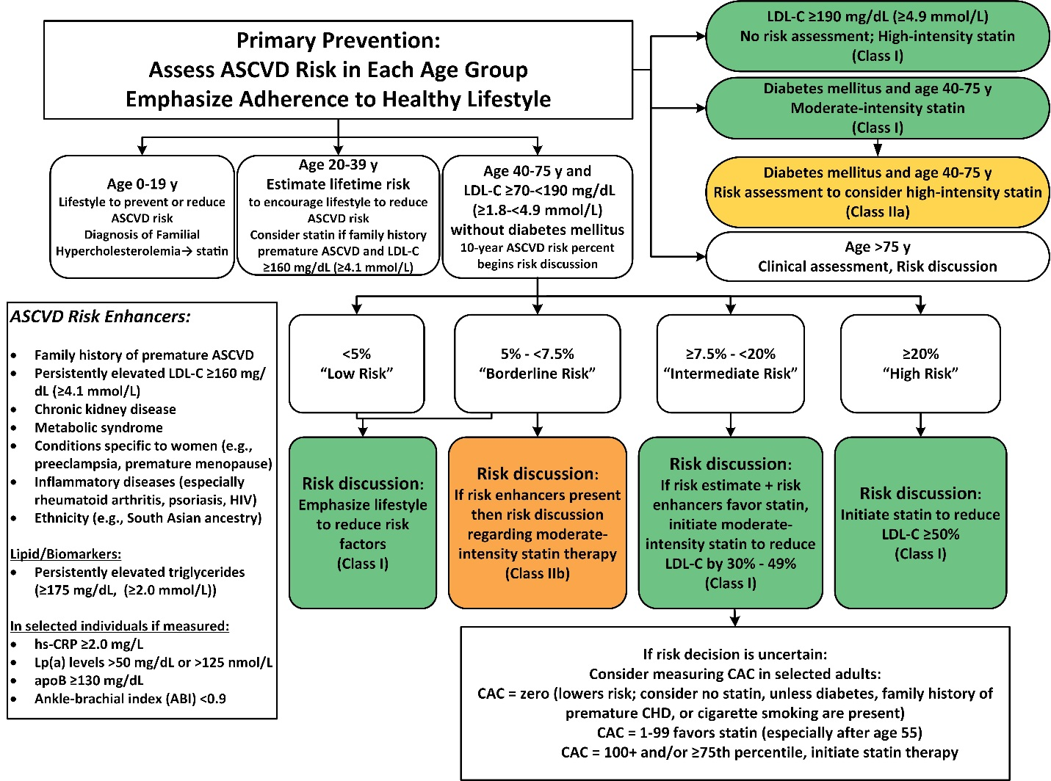

Slide 12
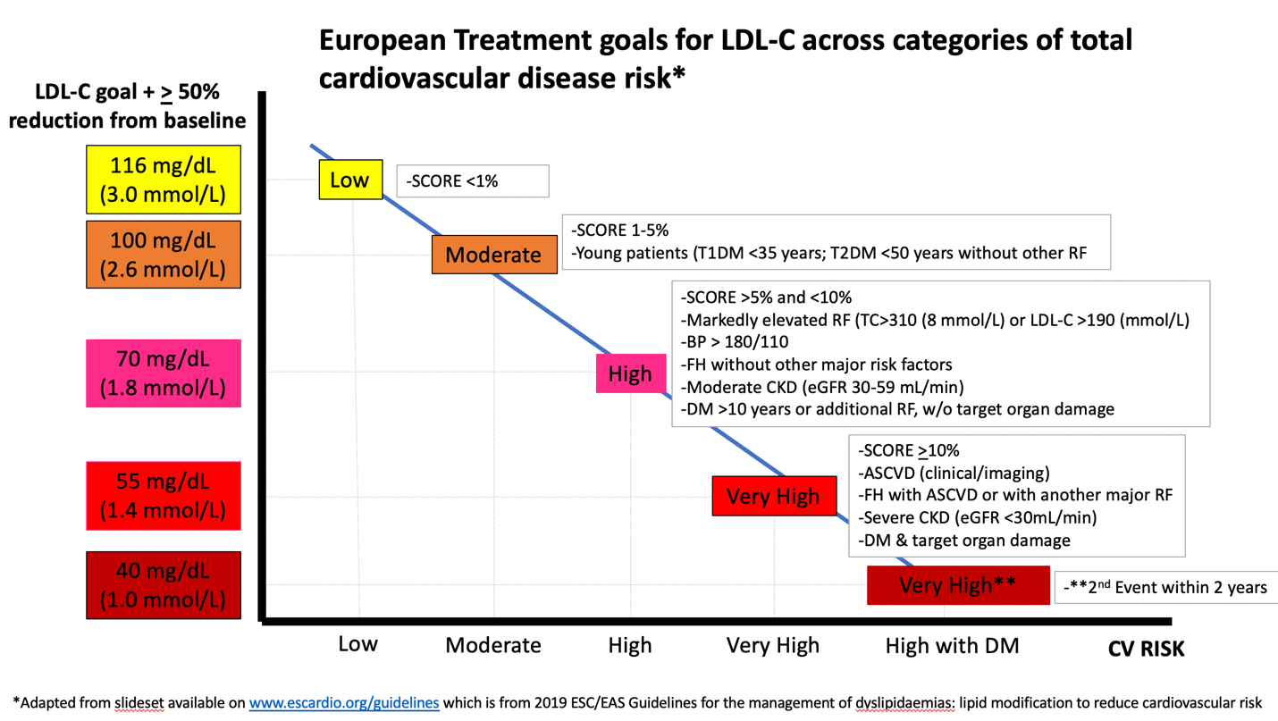
Treatment Goals for LDL-C across Categories of CVD risk

Slide 13
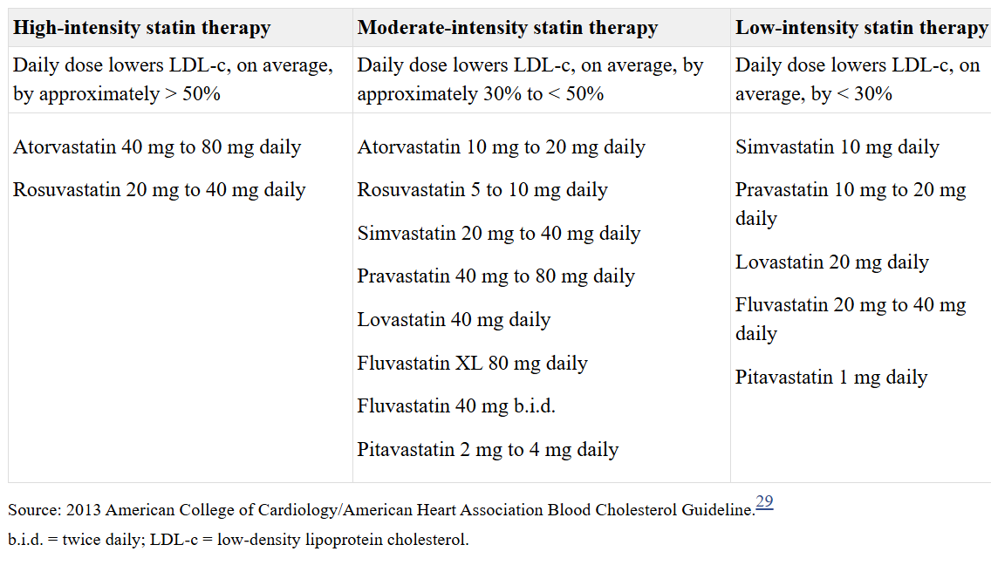
Definition of Statin Intensity

Slide 14
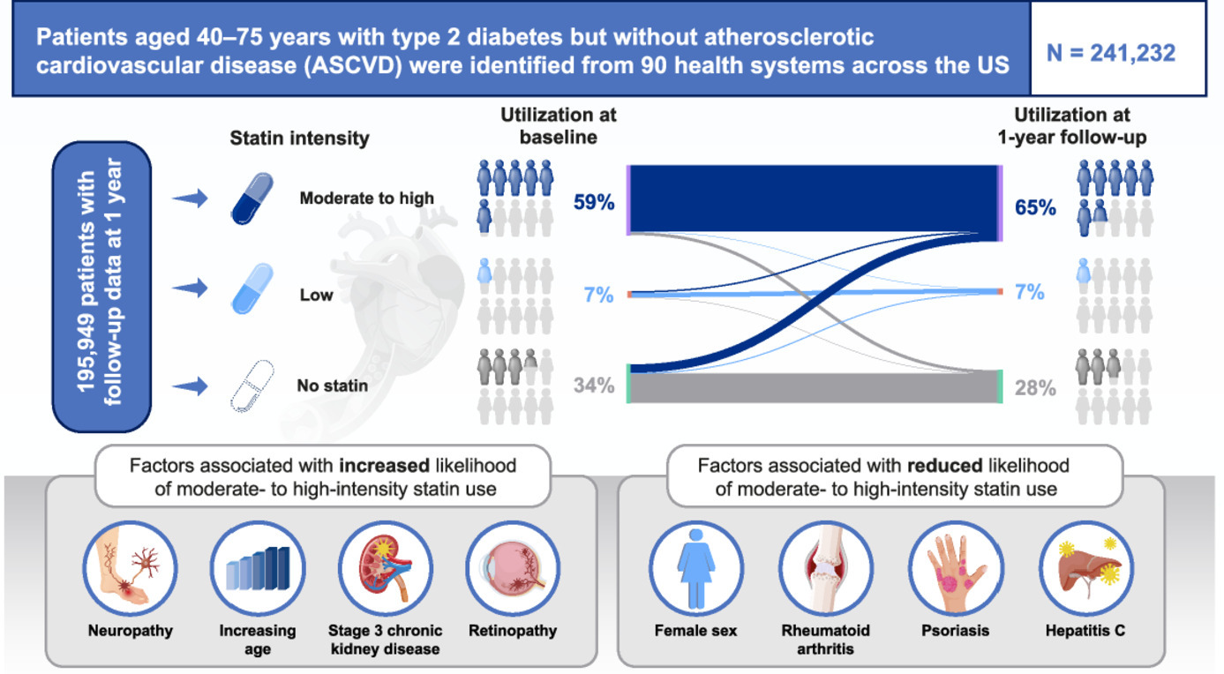
Challenges In Primary Prevention

Slide 15
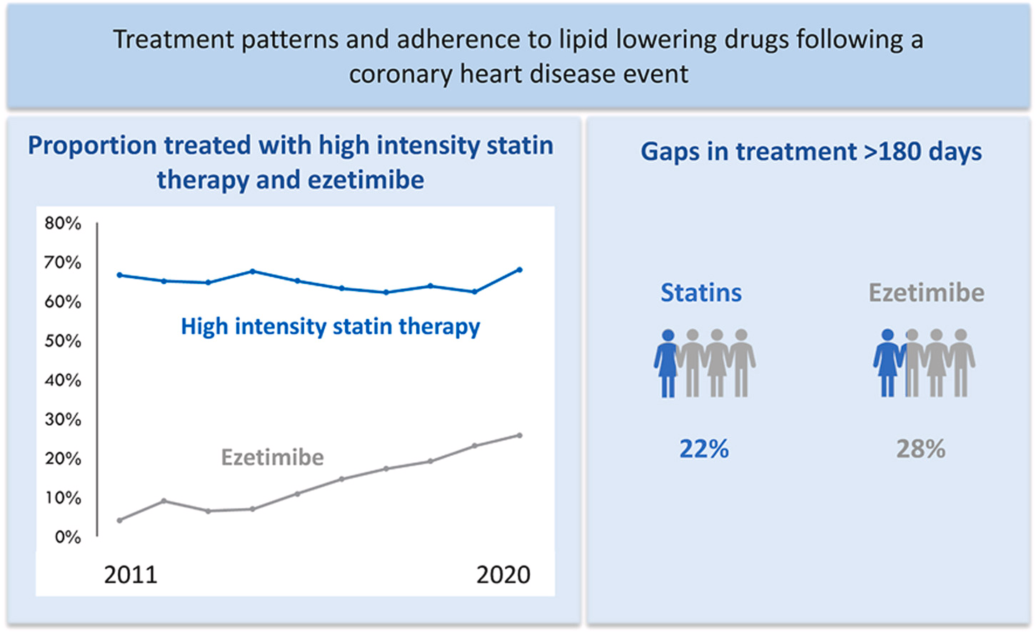
Challenges In Secondary Prevention
In this long-term follow-up of patients with CHD, less than 70 % used high-intensity statin therapy with only small changes over time, and only 25 % used additional treatment with ezetimibe.
Consistent across adherence measures, we found that more than one in five had poor long-term adherence to LLD.

Slide 16
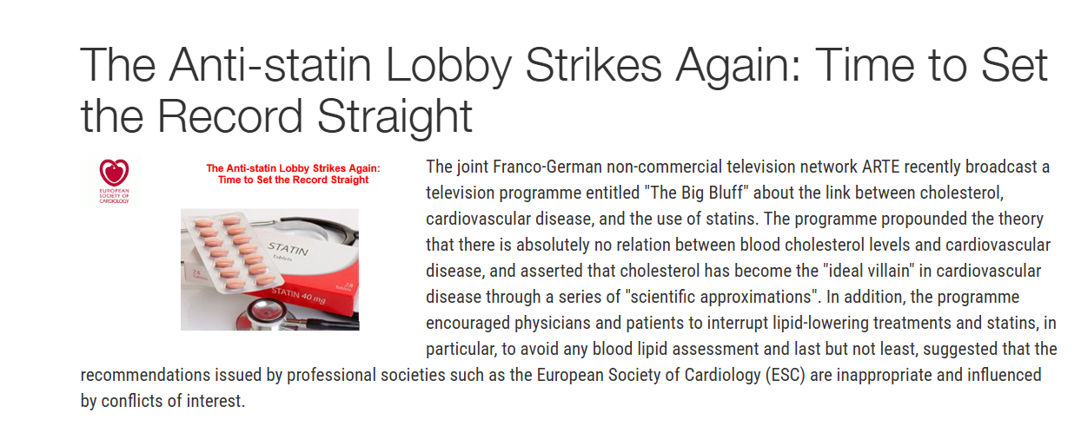
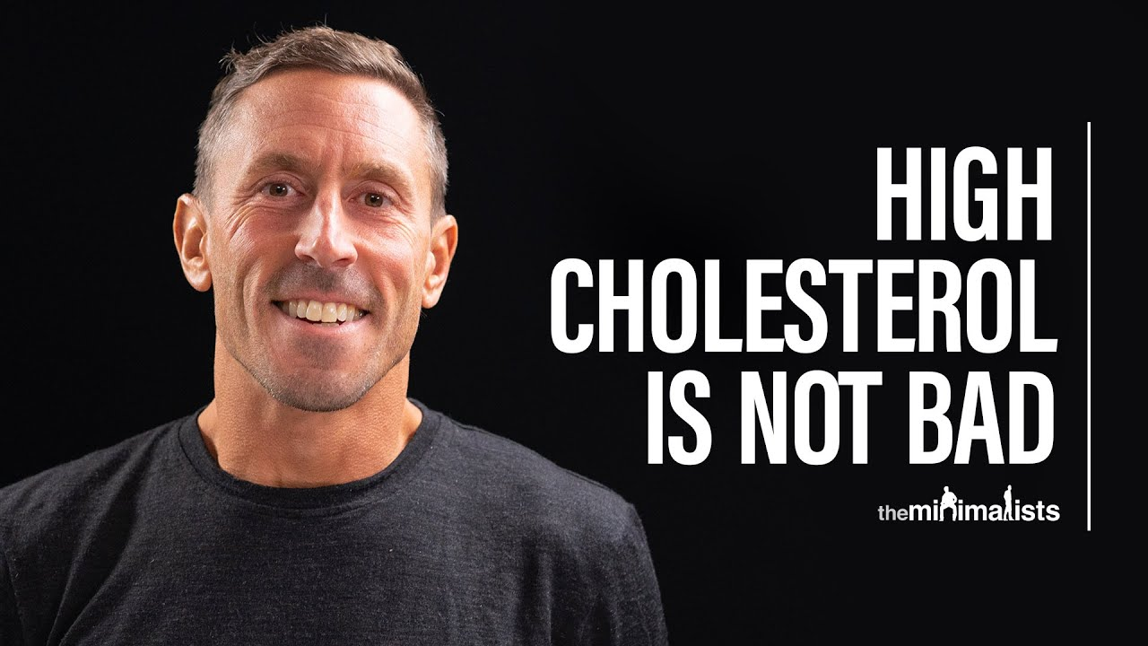


Slide 17
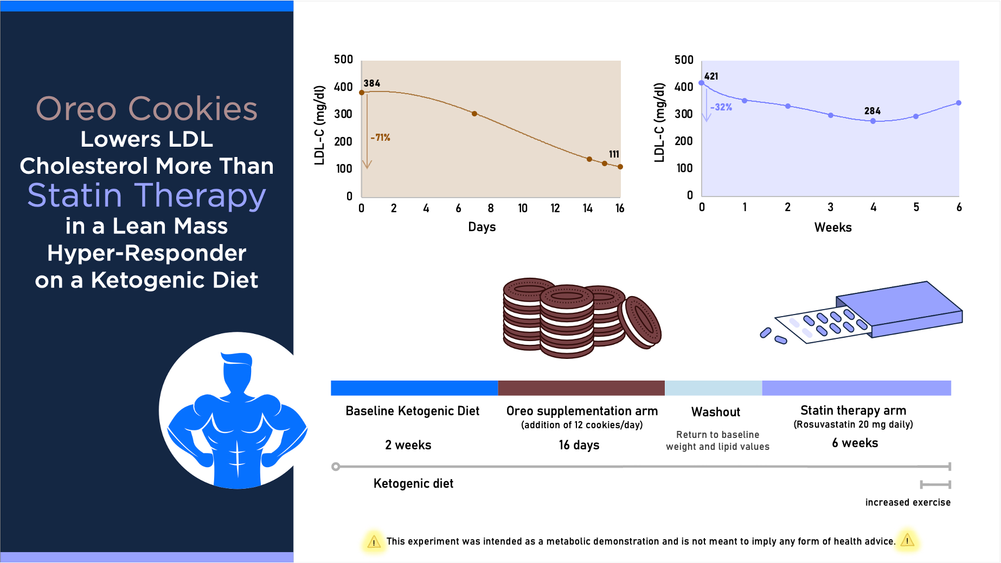
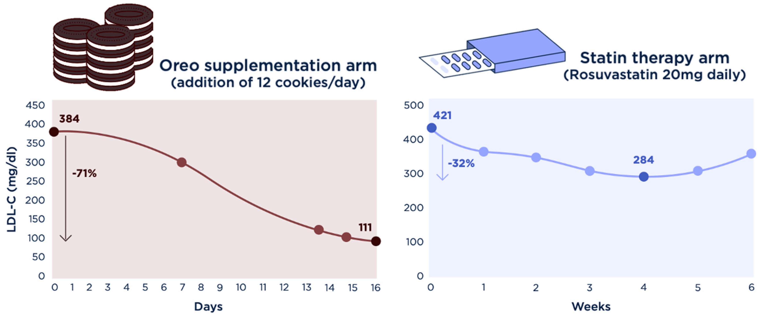
Oreo Cookie Treatment Lowers LDL Cholesterol More Than High-Intensity Statin therapy
Metabolites 2024, 14(1), 73; https://doi.org/10.3390/metabo14010073

Slide 18
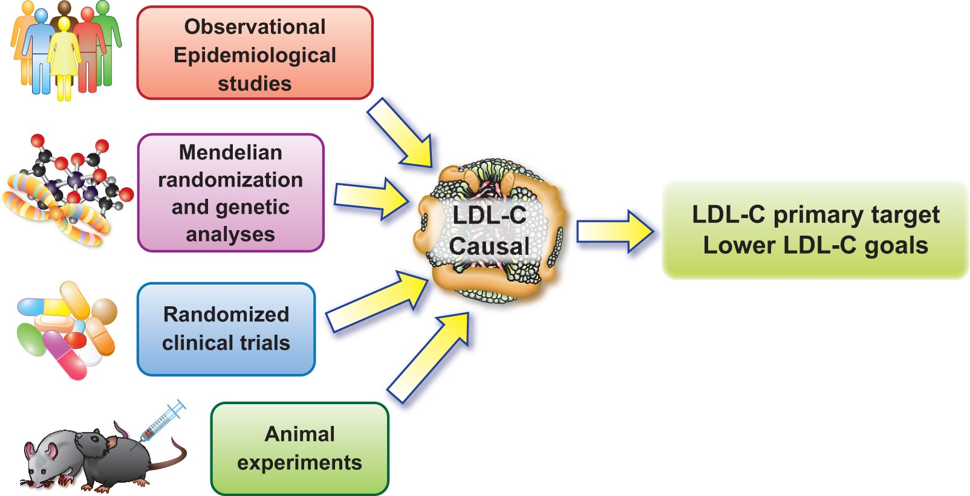
Multiple lines of evidence showing low-density lipoprotein cholesterol is causal for cardiovascular disease.
Notes:
Figure 2 Multiple lines of evidence showing low-density lipoprotein cholesterol is causal for cardiovascular disease. Data that have accrued from observational data, human genetic analyses, randomized clinical trial results, and animal experimentation in multiple species, all concordantly support a causal contribution of low-density lipoprotein to atherosclerosis.
Unless provided in the caption above, the following copyright applies to the content of this slide: Published on behalf of the European Society of Cardiology. All rights reserved. © The Author(s) 2022. For permissions, please email: journals.permissions@oup.com.This article is published and distributed under the terms of the Oxford University Press, Standard Journals Publication Model (https://academic.oup.com/journals/pages/open_access/funder_policies/chorus/standard_publication_model)

Slide 19
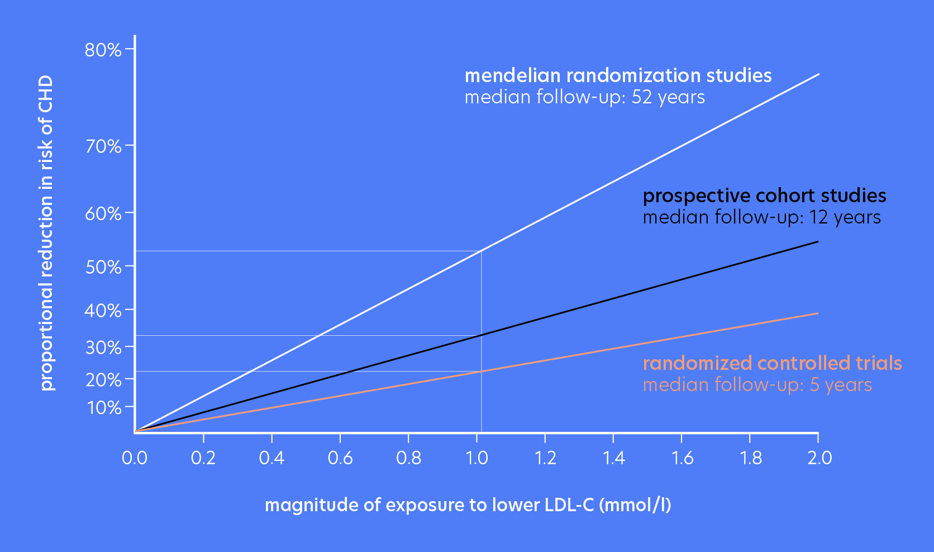
LDL Lowering

Slide 20
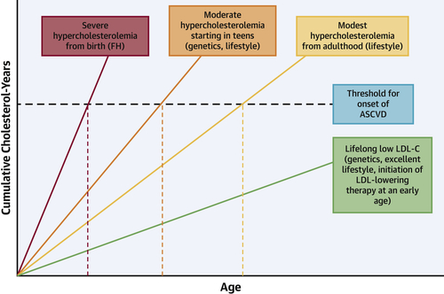
“Cholesterol-Years” for ASCVD Risk Prediction and Treatment
Michael D. Shapiro et al. JACC 2020; 76:1517-1520.

Slide 21
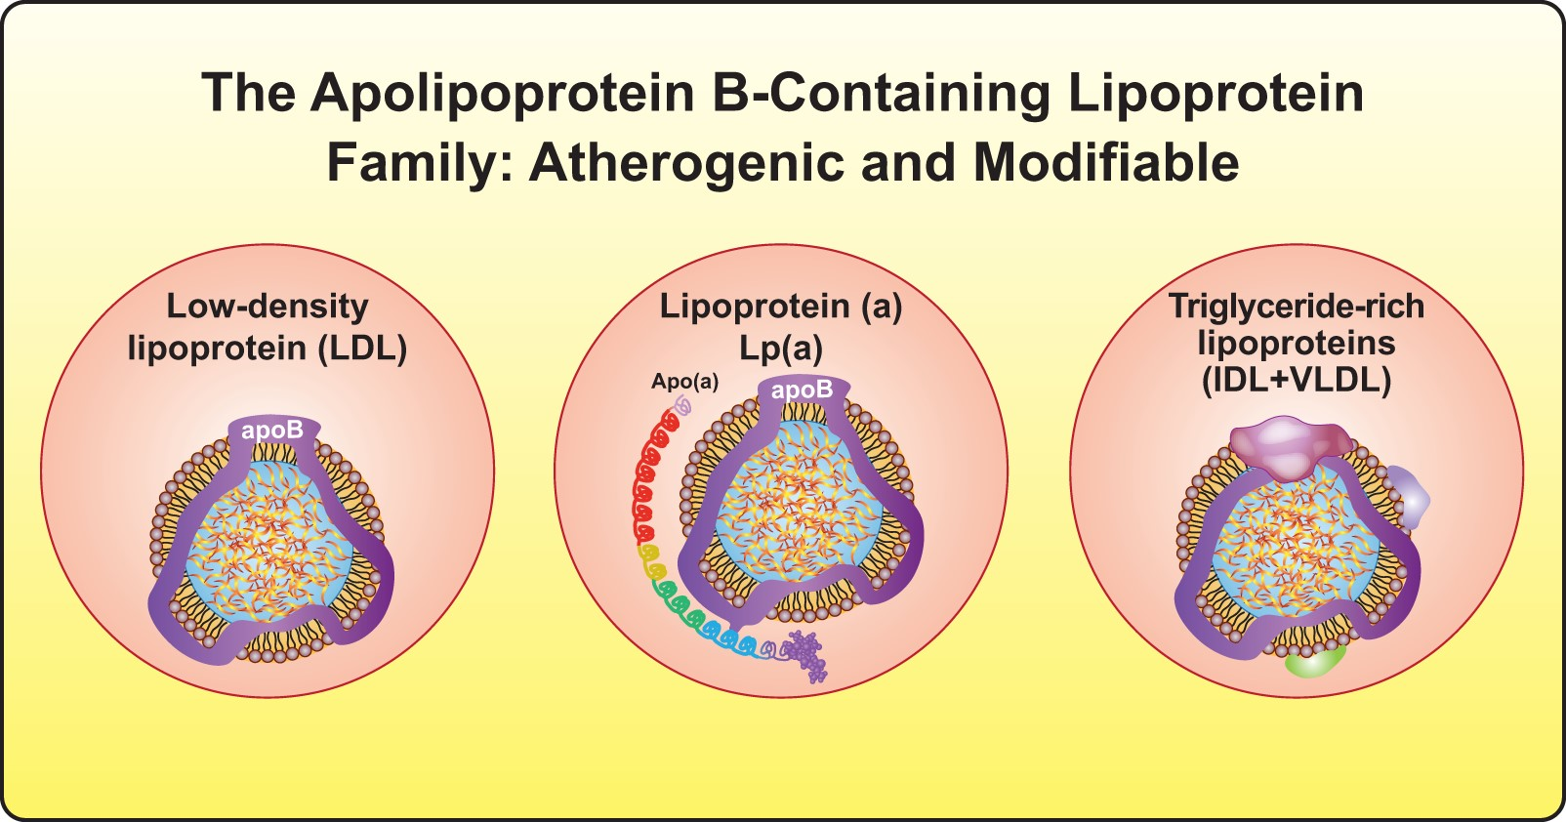
New targets for lipid-lowering therapies. Beyond low-density lipoprotein, lipoprotein(a)
Notes:
Figure 1 New targets for lipid-lowering therapies. Beyond low-density lipoprotein, lipoprotein(a) and triglyceride-rich lipoproteins or remnant lipoproteins have become actionable targets in lipid management. IDL, intermediate-density lipoprotein; VLDL, very low-density lipoprotein.
Unless provided in the caption above, the following copyright applies to the content of this slide: Published on behalf of the European Society of Cardiology. All rights reserved. © The Author(s) 2022. For permissions, please email: journals.permissions@oup.com.This article is published and distributed under the terms of the Oxford University Press, Standard Journals Publication Model (https://academic.oup.com/journals/pages/open_access/funder_policies/chorus/standard_publication_model)

Slide 22
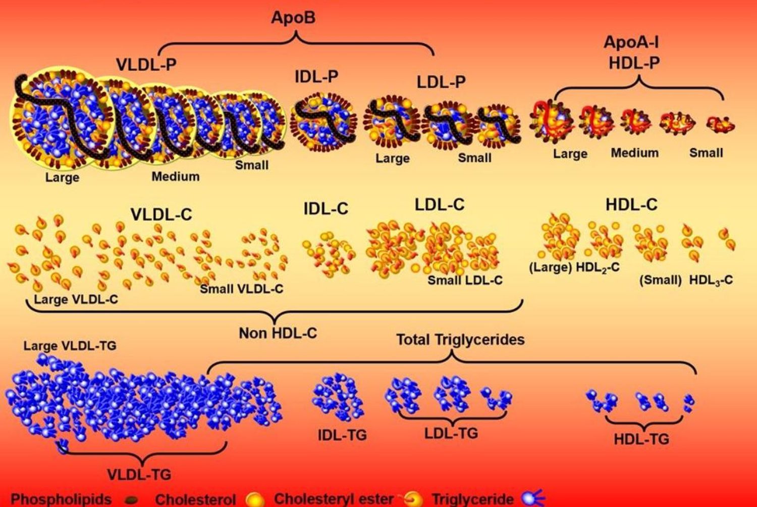
ApoB containing Lipoproteins

Slide 23
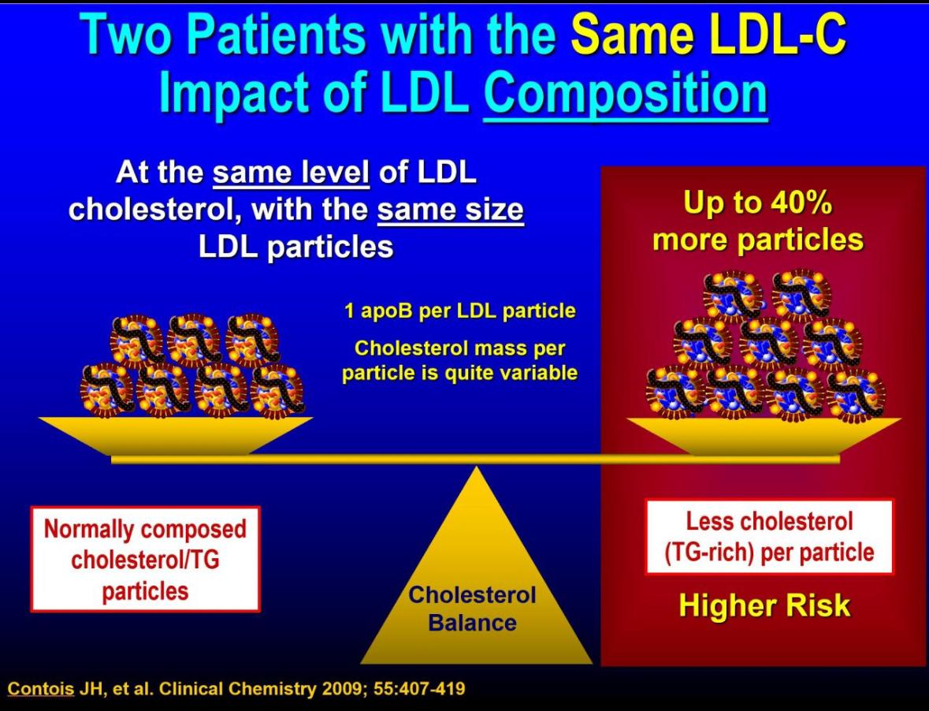

Slide 24
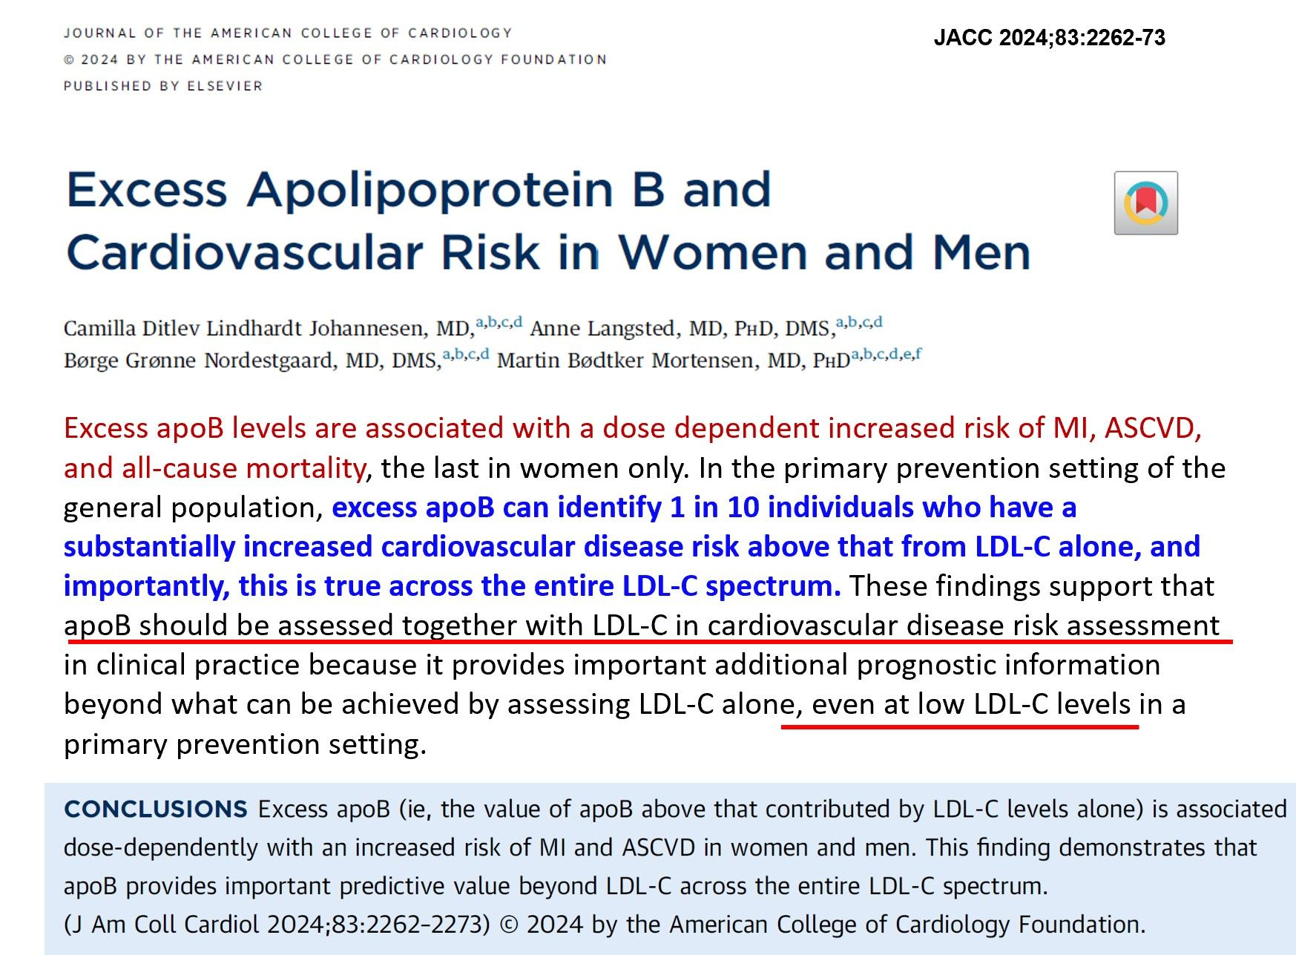

Slide 25
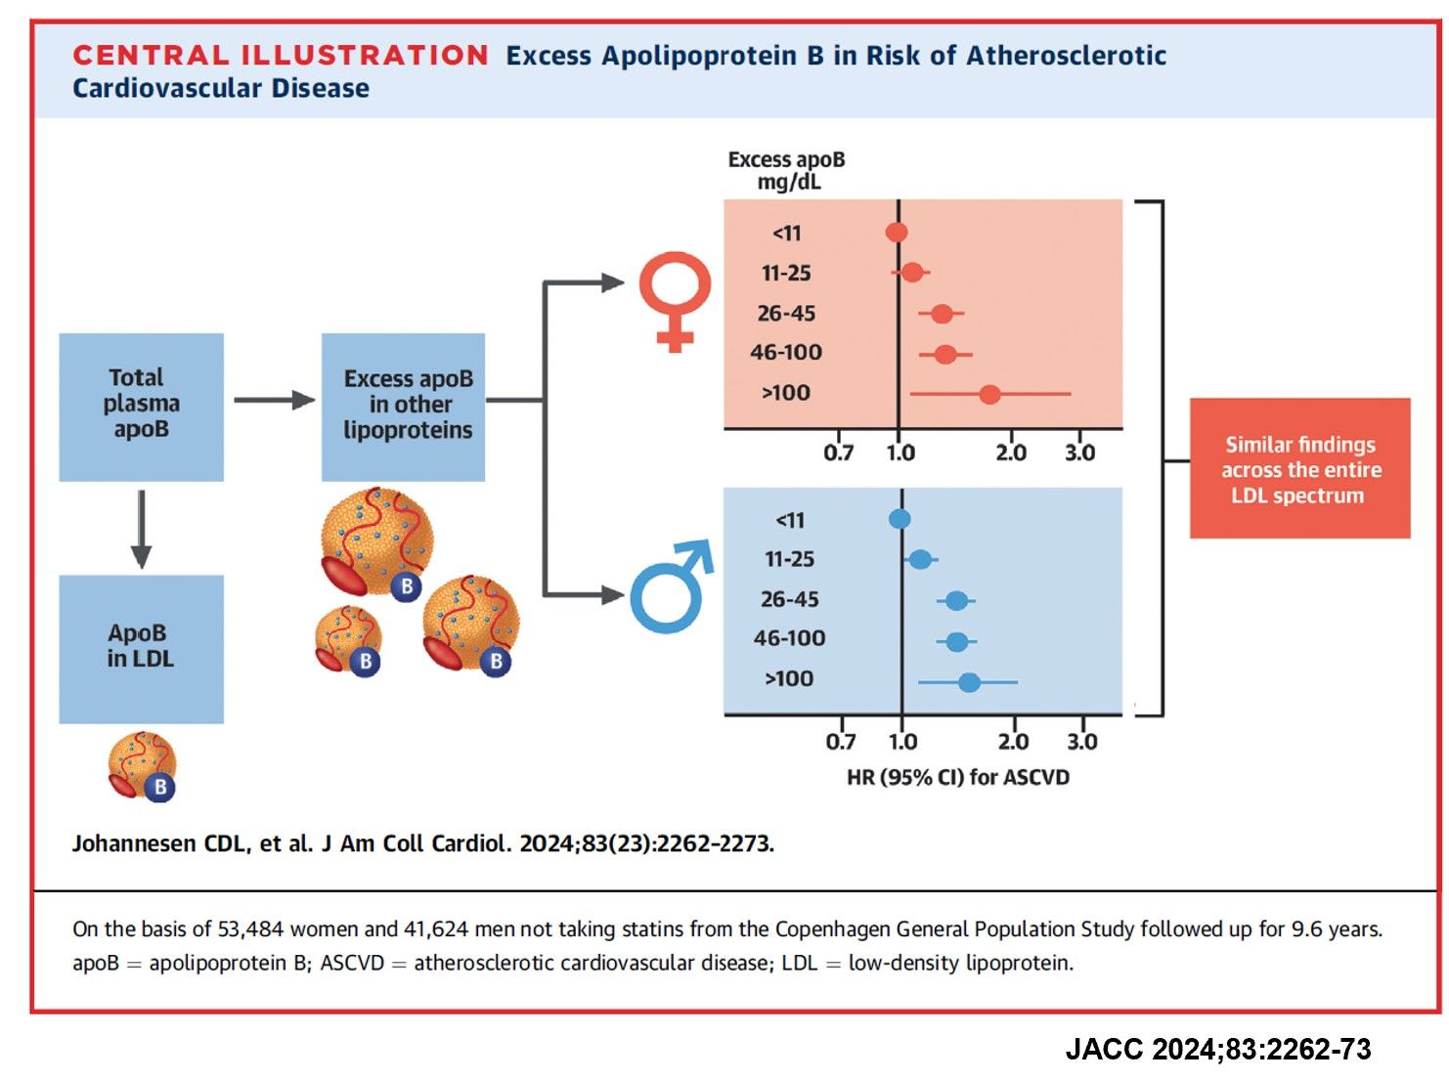
Excess Apolipoprotein B and ASCVD RISK

Slide 26
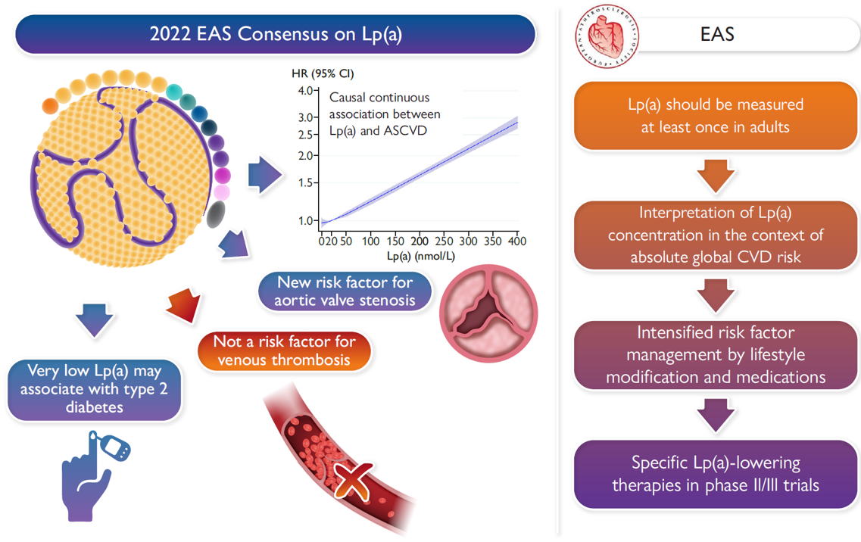
Lp(a) and ASCVD RISK

Slide 27
Combination Therapy

Slide 28
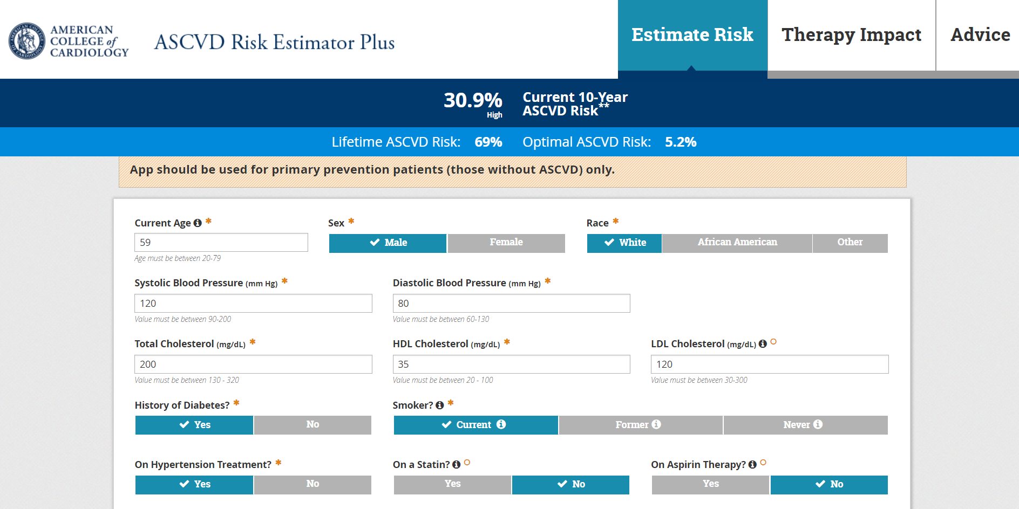
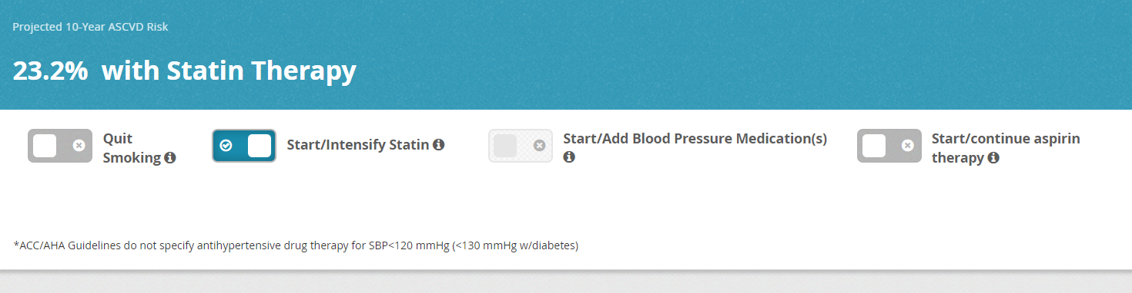

Slide 29
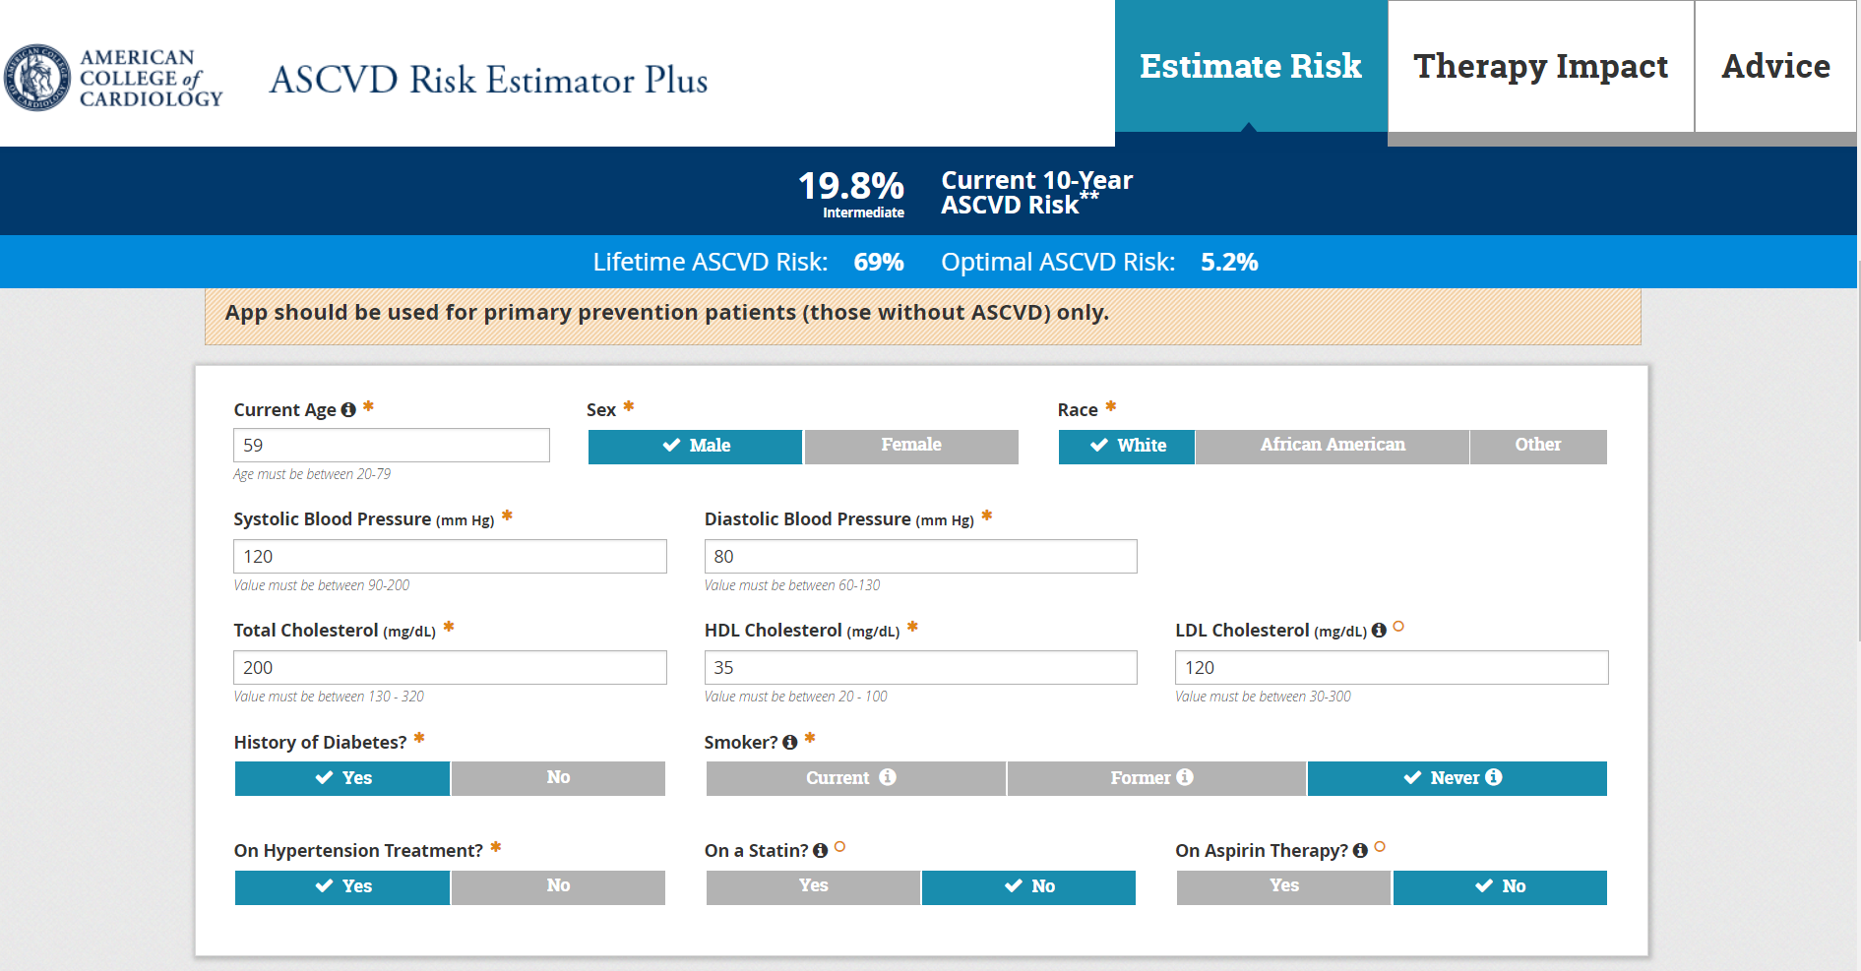
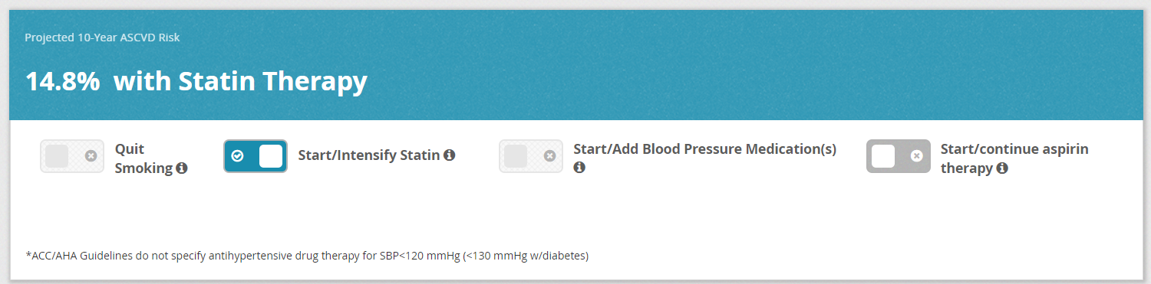

Slide 30
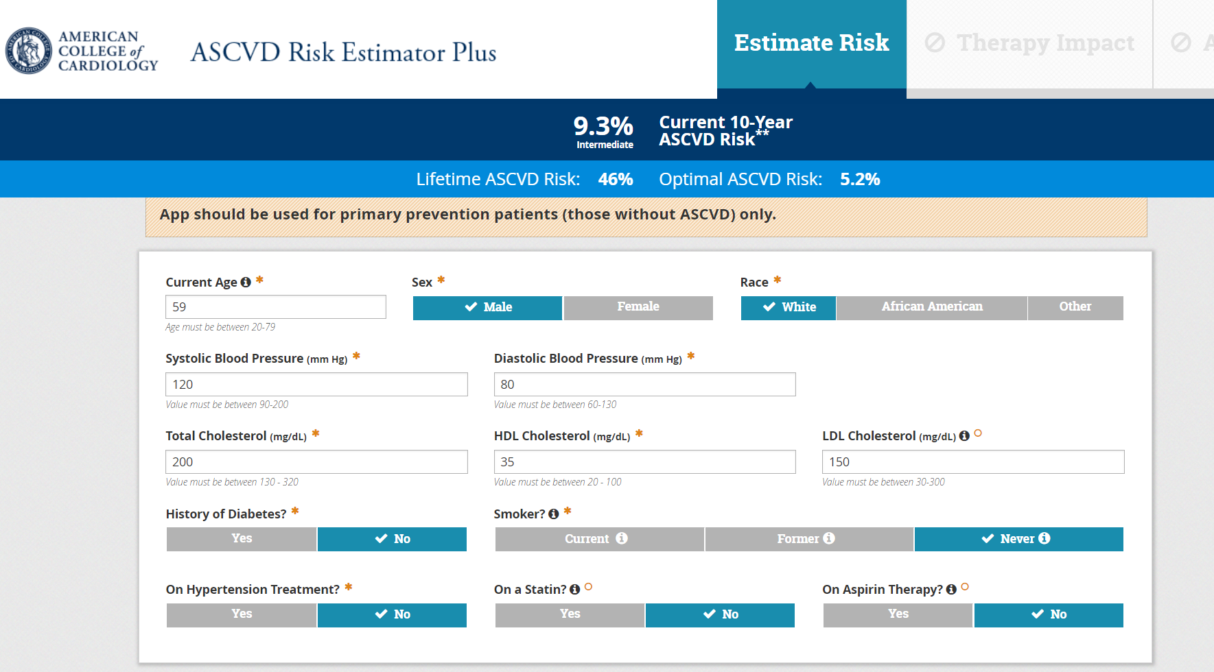
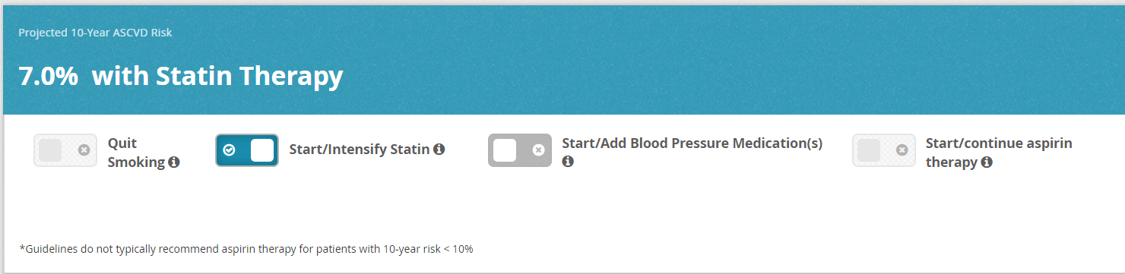

Slide 31
Impact of Statin on ASCVD Risk

Slide 32
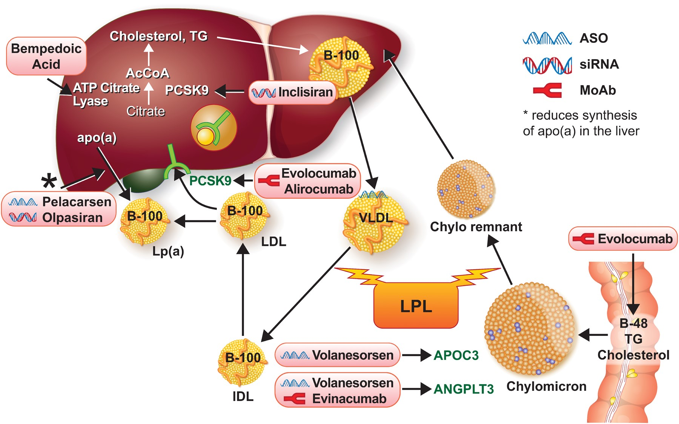
Newer and emerging lipid-lowering therapies target different aspects of lipid metabolism.
Notes:
Figure 5 Newer and emerging lipid-lowering therapies target different aspects of lipid metabolism. The statins target hydroxymethylglutaryl coenzyme A reductase. The newer and emerging agents target other aspects of lipid metabolism as shown here. B48 refers to the shorter form of apolipoprotein B produced by RNA editing in the intestine. B100 refers to the longer form produced in the liver. See the list for explanations of other abbreviations.
Unless provided in the caption above, the following copyright applies to the content of this slide: Published on behalf of the European Society of Cardiology. All rights reserved. © The Author(s) 2022. For permissions, please email: journals.permissions@oup.com.This article is published and distributed under the terms of the Oxford University Press, Standard Journals Publication Model (https://academic.oup.com/journals/pages/open_access/funder_policies/chorus/standard_publication_model)

Slide 33
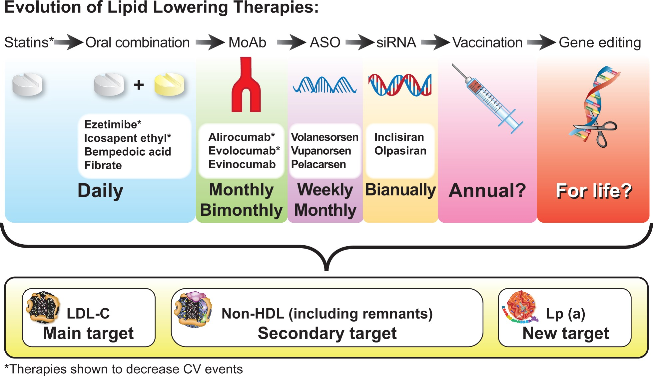
The future evolution of lipid-lowering therapies. The quest for new lipid-lowering therapies enabling less
Notes:
Graphical Abstract The future evolution of lipid-lowering therapies. The quest for new lipid-lowering therapies enabling less frequent administration is continuing. Outcome trials to show cardiovascular event reduction will determine their clinical application. ASO, antisense oligonucleotide; CV, cardiovascular; IPE, icosapent ethyl; LDL-C, low-density lipoprotein cholesterol; Lp(a), lipoprotein(a); MoAb, monoclonal antibodies; siRNA, small-interfering RNA.
Unless provided in the caption above, the following copyright applies to the content of this slide: Published on behalf of the European Society of Cardiology. All rights reserved. © The Author(s) 2022. For permissions, please email: journals.permissions@oup.com.This article is published and distributed under the terms of the Oxford University Press, Standard Journals Publication Model (https://academic.oup.com/journals/pages/open_access/funder_policies/chorus/standard_publication_model)

Slide 34
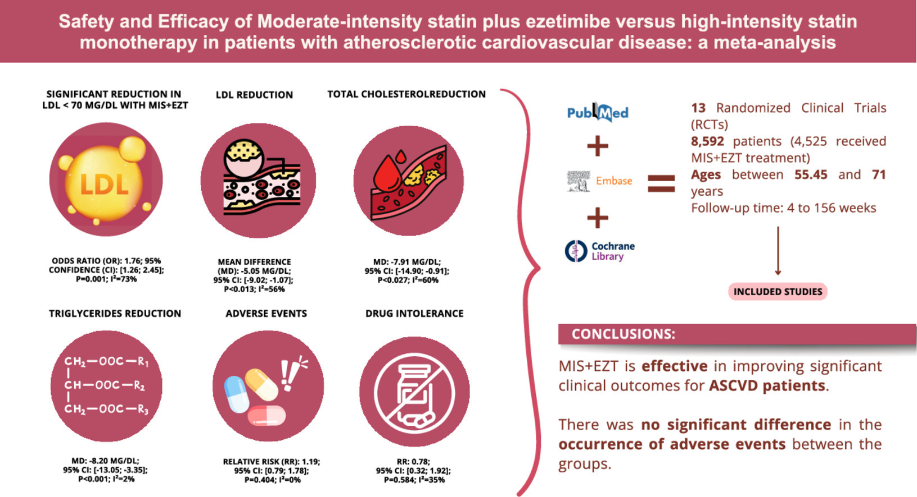
Drug Combinations
Kelly et al., Journal of Clinical Lipidology, 2024. ISSN 1933-2874.

Slide 35
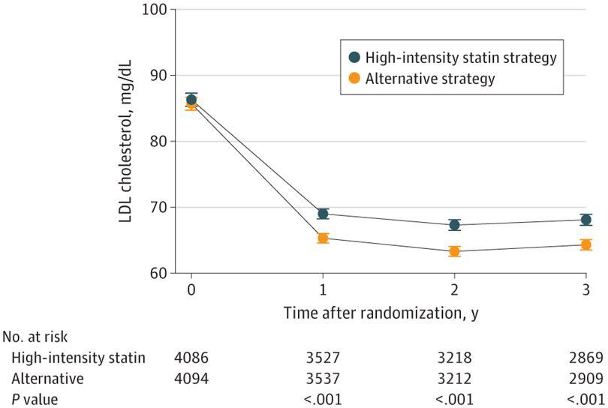
LDL Lowering

Slide 36
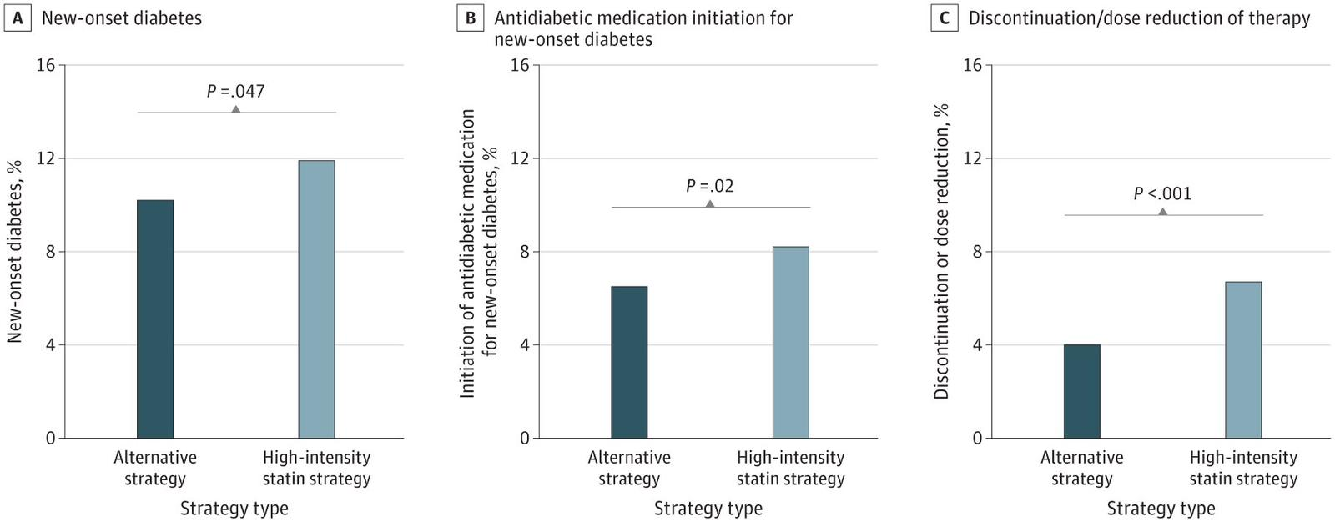
Impact of Combination Therapy

Slide 37
Highlights
Compared moderated intensity statins (MIS) +Ezetimibe (EZT) with high intensity statins (HIS) in ASCVD. All the lastest meta-analysis included low/moderated intensity statins + ezetimibe versus high intensity statins.
MIS+EZT achieved greater LDL reduction than HIS.
There were no signifficant difference in incidence of MACE between the groups.
More patients achieved LDL goal (<70) with MIS+EZT.
MIS+EZT showed similar safety profile to HIS.
Meta-analysis suggests MIS+EZT may be a more effective treatment.
Kelly et al., Journal of Clinical Lipidology, 2024. ISSN 1933-2874.

Slide 38
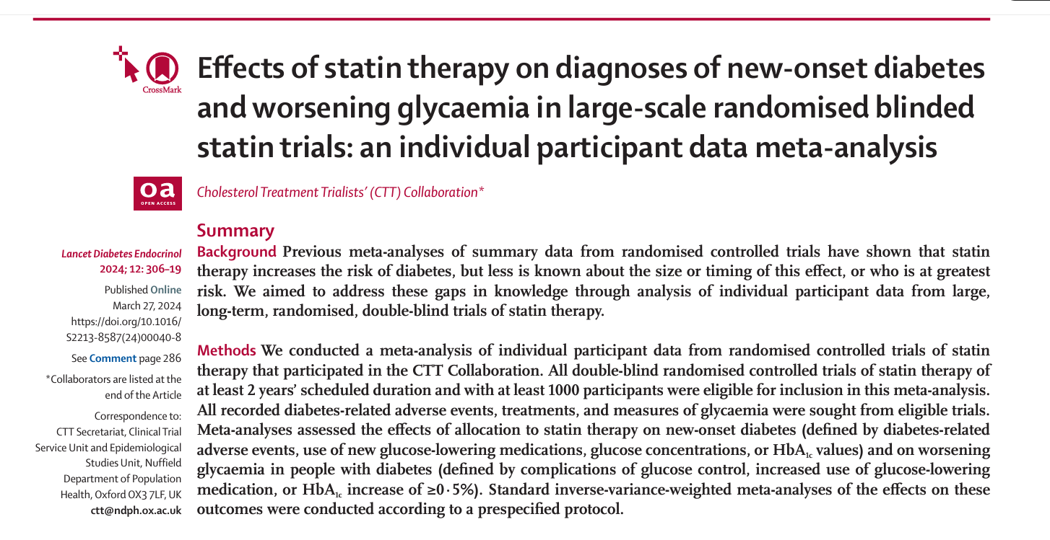
Do Statins Cause Diabetes?

Slide 39
Findings
19 trials compared statin versus placebo (123 940 participants, 25 701 [21%] with diabetes; median follow-up of 4·3 years), and four trials compared more versus less intensive statin therapy (30 724 participants, 5340 [17%] with diabetes, median follow-up of 4·9 years).
Of the trials participating in the CTT Collaboration, 19 trials compared statin versus placebo (123 940 participants, 25 701 [21%] with diabetes; median follow-up of 4·3 years), and four trials compared more versus less intensive statin therapy (30 724 participants, 5340 [17%] with diabetes, median follow-up of 4·9 years). Compared with placebo, allocation to low-intensity or moderate-intensity statin therapy resulted in a 10% proportional increase in new-onset diabetes (2420 of 39 179 participants assigned to receive a statin [1·3% per year] vs 2214 of 39 266 participants assigned to receive placebo [1·2% per year]; rate ratio [RR] 1·10, 95% CI 1·04–1·16), and allocation to high-intensity statin therapy resulted in a 36% proportional increase (1221 of 9935 participants assigned to receive a statin [4·8% per year] vs 905 of 9859 participants assigned to receive placebo [3·5% per year]; 1·36, 1·25–1·48). For each trial, the rate of newonset diabetes among participants allocated to receive placebo depended mostly on the proportion of participants who had at least one follow-up HbA1c measurement; this proportion was much higher in the high-intensity than the lowintensity or moderate-intensity trials. Consequently, the main determinant of the magnitude of the absolute excesses in the two types of trial was the extent of HbA1c measurement rather than the proportional increase in risk associated with statin therapy. In participants without baseline diabetes, mean glucose increased by 0·04 mmol/L with both lowintensity or moderate-intensity (95% CI 0·03–0·05) and high-intensity statins (0·02–0·06), and mean HbA1c increased by 0·06% (0·00–0·12) with low-intensity or moderate-intensity statins and 0·08% (0·07–0·09) with high-intensity statins. Among those with a baseline measure of glycaemia, approximately 62% of new-onset diabetes cases were among participants who were already in the top quarter of the baseline distribution. The relative effects of statin therapy on new-onset diabetes were similar among different types of participants and over time. Among participants with baseline diabetes, the RRs for worsening glycaemia were 1·10 (1·06–1·14) for low-intensity or moderate-intensity statin therapy and 1·24 (1·06–1·44) for high-intensity statin therapy compared with placebo.
Compared with placebo, allocation to low-intensity or moderate-intensity statin therapy resulted in a 10% proportional increase in new-onset diabetes (2420 of 39 179 participants assigned to receive a statin [1·3% per year] vs 2214 of 39 266 participants assigned to receive placebo [1·2% per year]; rate ratio [RR] 1·10, 95% CI 1·04–1·16)
0.1% Increase T2D Risk
and allocation to high-intensity statin therapy resulted in a 36% proportional increase (1221 of 9935 participants assigned to receive a statin [4·8% per year] vs 905 of 9859 participants assigned to receive placebo [3·5% per year]; 1·36, 1·25–1·48).
1.3% Increase T2D Risk
For each trial, the rate of newonset diabetes among participants allocated to receive placebo depended mostly on the proportion of participants who had at least one follow-up HbA1c measurement; this proportion was much higher in the high-intensity than the lowintensity or moderate-intensity trials.

Slide 40
Number of Newly Diagnosed T2D/1000

Slide 41
Number of Newly Diagnosed T2D/1000 vs ASCVD events Prevented

Slide 42
Quiz? Who IS diabetic

Slide 43
So, What?
By contrast, among people with a known diagnosis of diabetes at baseline, the early excess of worsening glycaemia with a statin did not persist in the long term (appendix pp 26–27), perhaps because glycaemic control is typically monitored in such individuals and likely to be managed.

Slide 44
Newer and emerging lipid-lowering therapies target different aspects of lipid metabolism.
Notes:
Figure 5 Newer and emerging lipid-lowering therapies target different aspects of lipid metabolism. The statins target hydroxymethylglutaryl coenzyme A reductase. The newer and emerging agents target other aspects of lipid metabolism as shown here. B48 refers to the shorter form of apolipoprotein B produced by RNA editing in the intestine. B100 refers to the longer form produced in the liver. See the list for explanations of other abbreviations.
Unless provided in the caption above, the following copyright applies to the content of this slide: Published on behalf of the European Society of Cardiology. All rights reserved. © The Author(s) 2022. For permissions, please email: journals.permissions@oup.com.This article is published and distributed under the terms of the Oxford University Press, Standard Journals Publication Model (https://academic.oup.com/journals/pages/open_access/funder_policies/chorus/standard_publication_model)

Slide 45
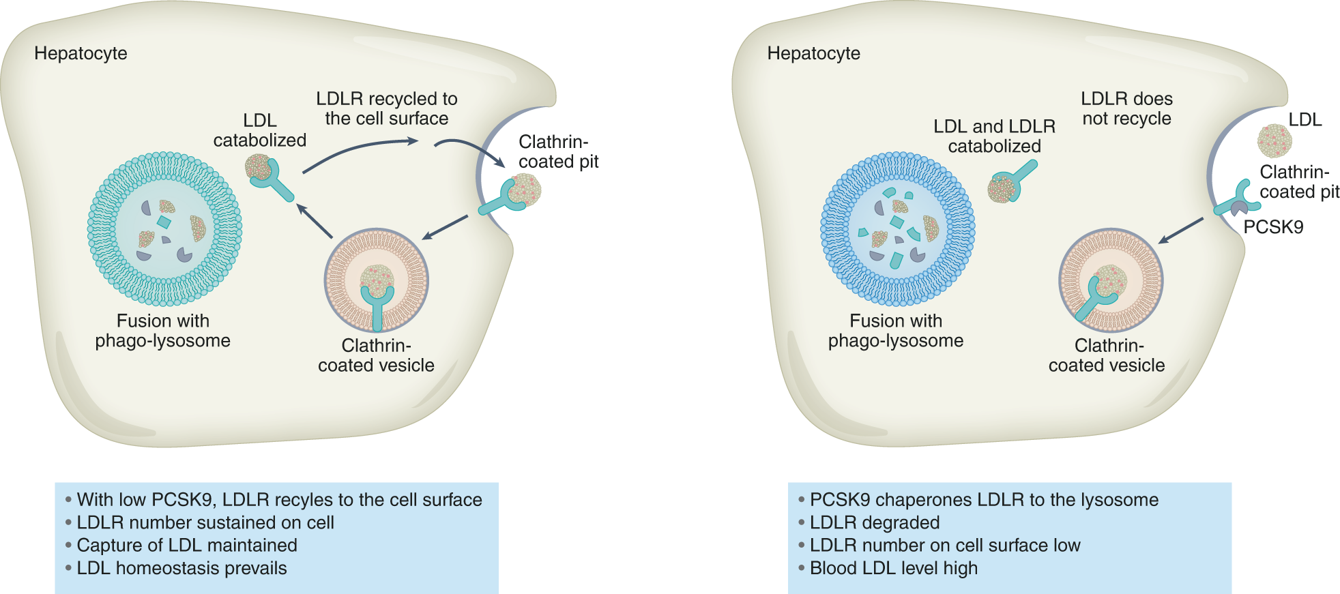
PCSK9 Function

Slide 46
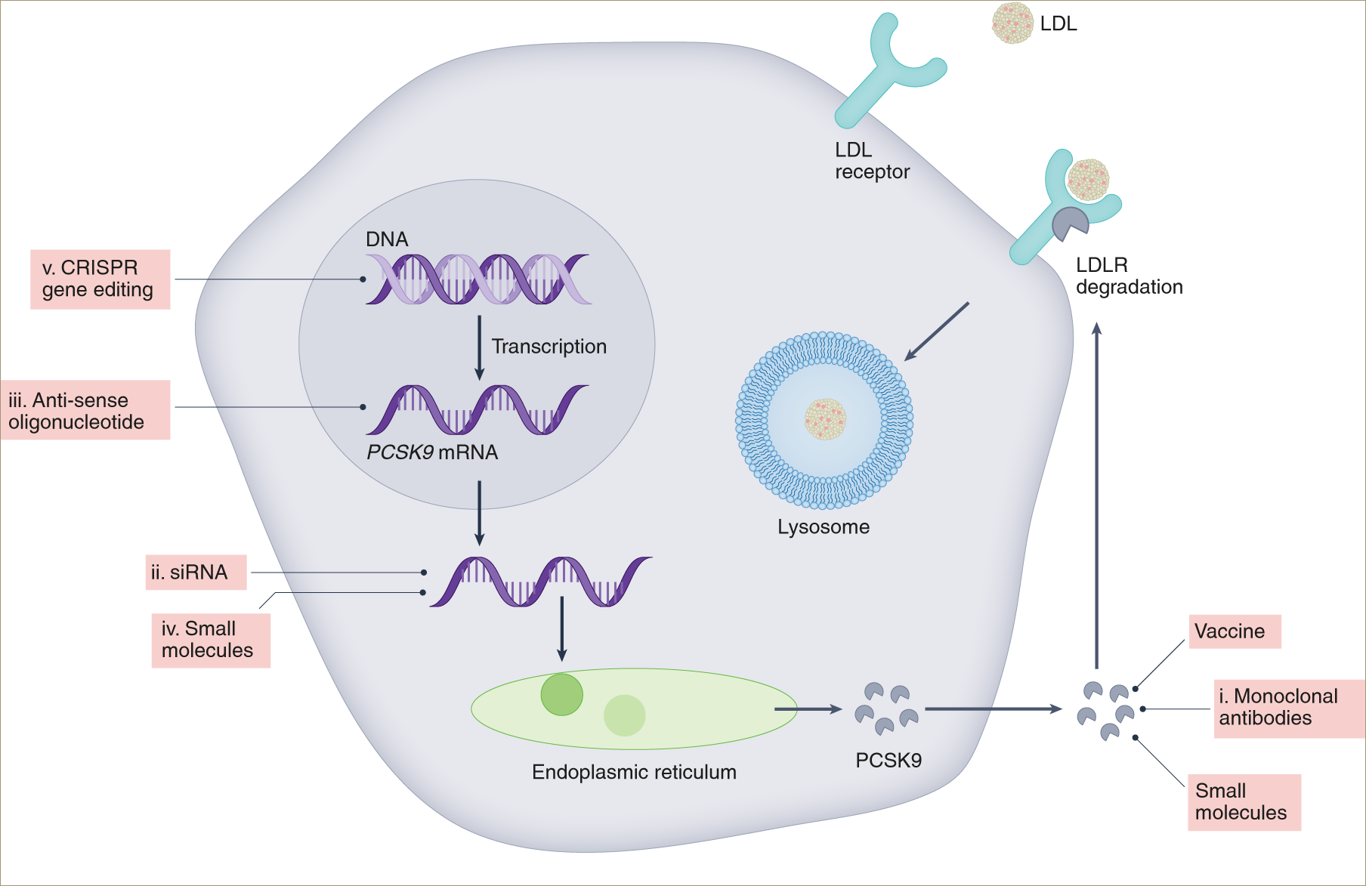
Ways to target PCSK9

Slide 47
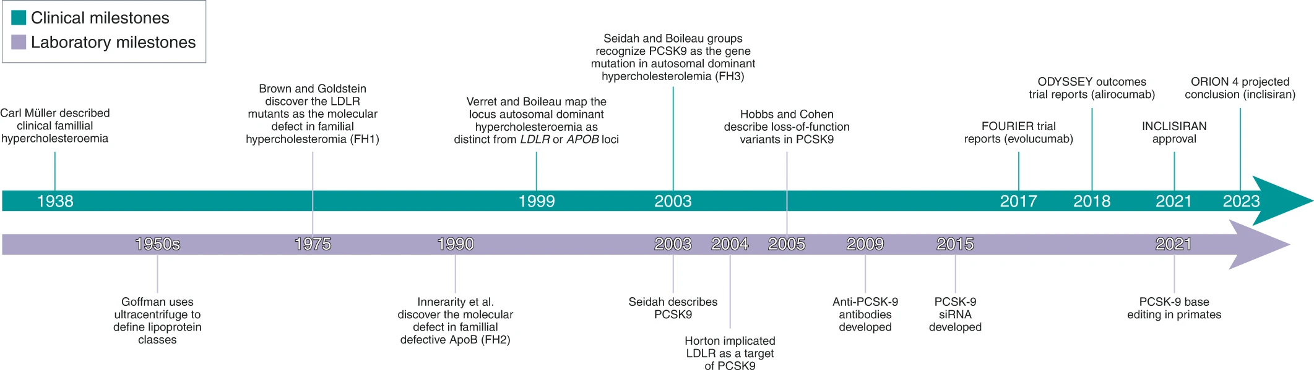
Chasing LDL cholesterol to the bottom — PCSK9 in perspective

Slide 48
Evolocumab and Clinical Outcomes in Patients with Cardiovascular Disease
In this trial, 27,564 patients with cardiovascular disease and LDL cholesterol levels of 70 mg per deciliter or higher on statin therapy were assigned to either evolocumab or placebo.
At 2.2 years, the evolocumab group had a significantly lower rate of major adverse cardiovascular events.
N Engl J Med, Volume 376(18):1713-1722, May 4, 2017

Slide 49
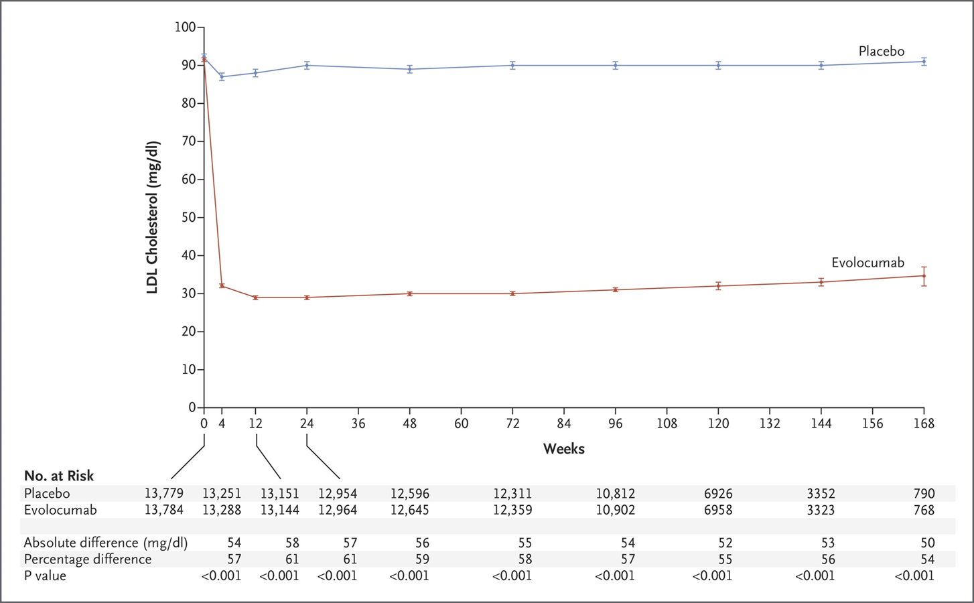
Low-Density Lipoprotein (LDL) Cholesterol Levels over Time.
N Engl J Med, Volume 376(18):1713-1722, May 4, 2017
Notes:
Figure 1 Low-Density Lipoprotein (LDL) Cholesterol Levels over Time. Shown are median values in the two study groups; I bars indicate 95% confidence intervals. Below the graph, the absolute and percentage reductions in LDL cholesterol level in the evolocumab group are compared with those in the placebo group and are presented as least-squares means or means (details are provided in the Methods section in the Supplementary Appendix). To convert the values for cholesterol to millimoles per liter, multiply by 0.02586.

Slide 50
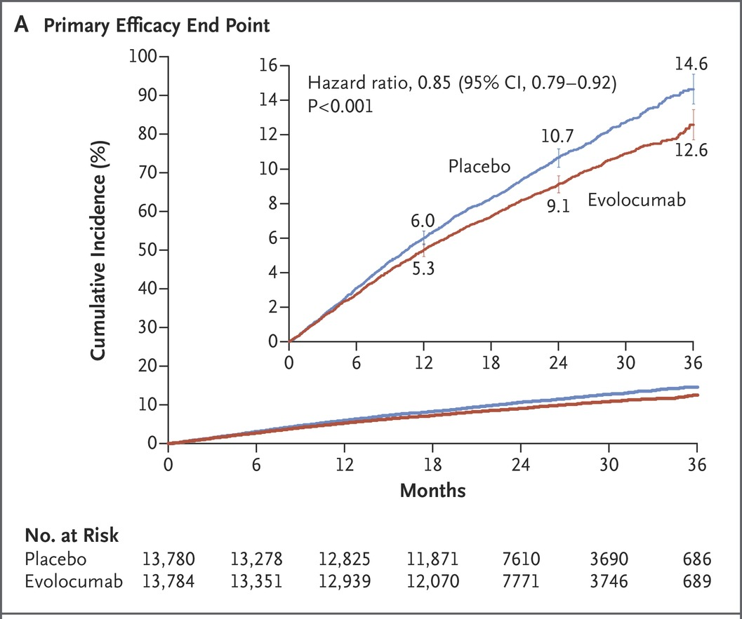
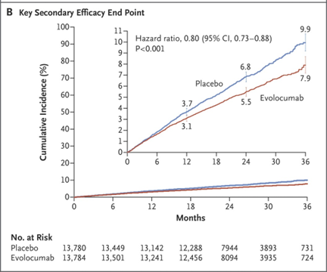
Cumulative Incidence of Cardiovascular Events
N Engl J Med, Volume 376(18):1713-1722, May 4, 2017
Notes:
Figure 2 Cumulative Incidence of Cardiovascular Events. Panel A shows the cumulative event rates for the primary efficacy end point (the composite of cardiovascular death, myocardial infarction, stroke, hospitalization for unstable angina, or coronary revascularization), and Panel B shows the rates for the key secondary efficacy end point (the composite of cardiovascular death, myocardial infarction, or stroke). I bars indicate 95% confidence intervals. The Kaplan–Meier rates for the primary end point in the evolocumab group versus the placebo group were as follows: at 1 year, 5.3% (95% confidence interval [CI], 4.9 to 5.7) versus 6.0% (95% CI, 5.6 to 6.4); at 2 years, 9.1% (95% CI, 8.6 to 9.6) versus 10.7% (95% CI, 10.1 to 11.2); and at 3 years, 12.6% (95% CI, 11.7 to 13.5) versus 14.6% (95% CI, 13.8 to 15.5). The Kaplan–Meier rates for the key secondary end point in the evolocumab group versus the placebo group were as follows: at 1 year, 3.1% (95% CI, 2.8 to 3.4) versus 3.7% (95% CI, 3.4 to 4.0); at 2 years, 5.5% (95% CI, 5.1 to 5.9) versus 6.8% (95% CI, 6.4 to 7.3); and at 3 years, 7.9% (95% CI, 7.2 to 8.7) versus 9.9% (95% CI, 9.2 to 10.7). P values were calculated with the use of log-rank tests. The insets show the same data on an enlarged y axis.

Slide 51
Conclusions
In our trial, inhibition of PCSK9 with evolocumab on a background of statin therapy lowered LDL cholesterol levels to a median of 30 mg per deciliter (0.78 mmol per liter) and reduced the risk of cardiovascular events.
These findings show that patients with atherosclerotic cardiovascular disease benefit from lowering of LDL cholesterol levels below current targets.

Slide 52
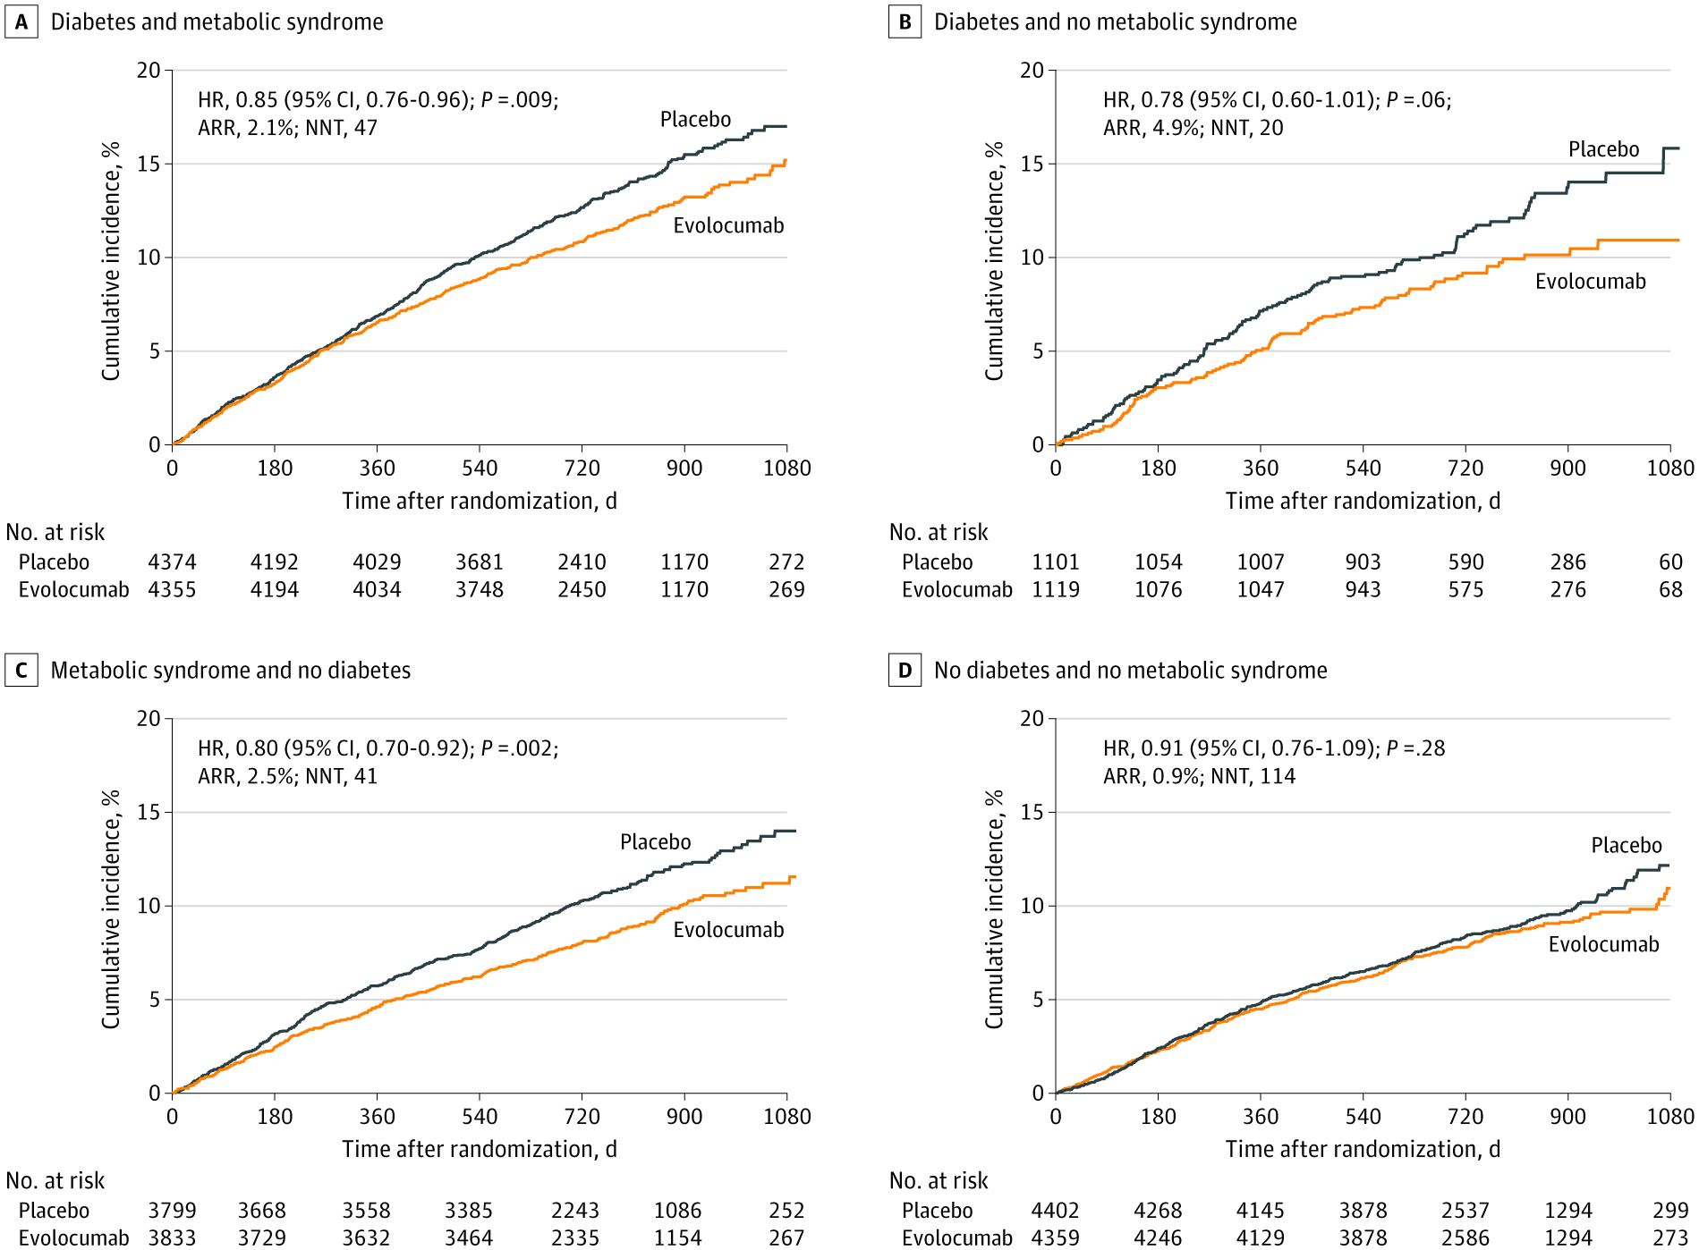
Efficacy and Safety of PCSK9 Inhibition With Evolocumab in Reducing Cardiovascular Events in Patients With Metabolic Syndrome Receiving Statin Therapy: Secondary Analysis From the FOURIER Randomized Clinical Trial
JAMA Cardiol. 2021;6(2):139-147. doi:10.1001/jamacardio.2020.3151

Slide 53
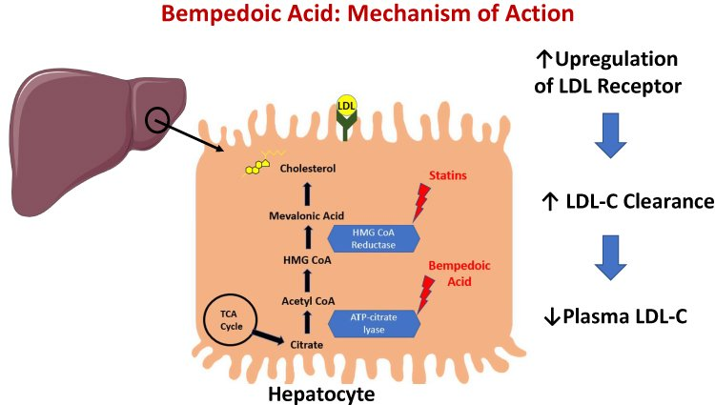
Bempedoic Acid

Slide 54
Bempedoic Acid and Cardiovascular Outcomes in Statin-Intolerant Patients
In this randomized trial, statin-intolerant patients with, or at high risk for, CVD received bempedoic acid or placebo.
Bempedoic acid reduced LDL cholesterol and the risk of cardiovascular events.

Slide 55
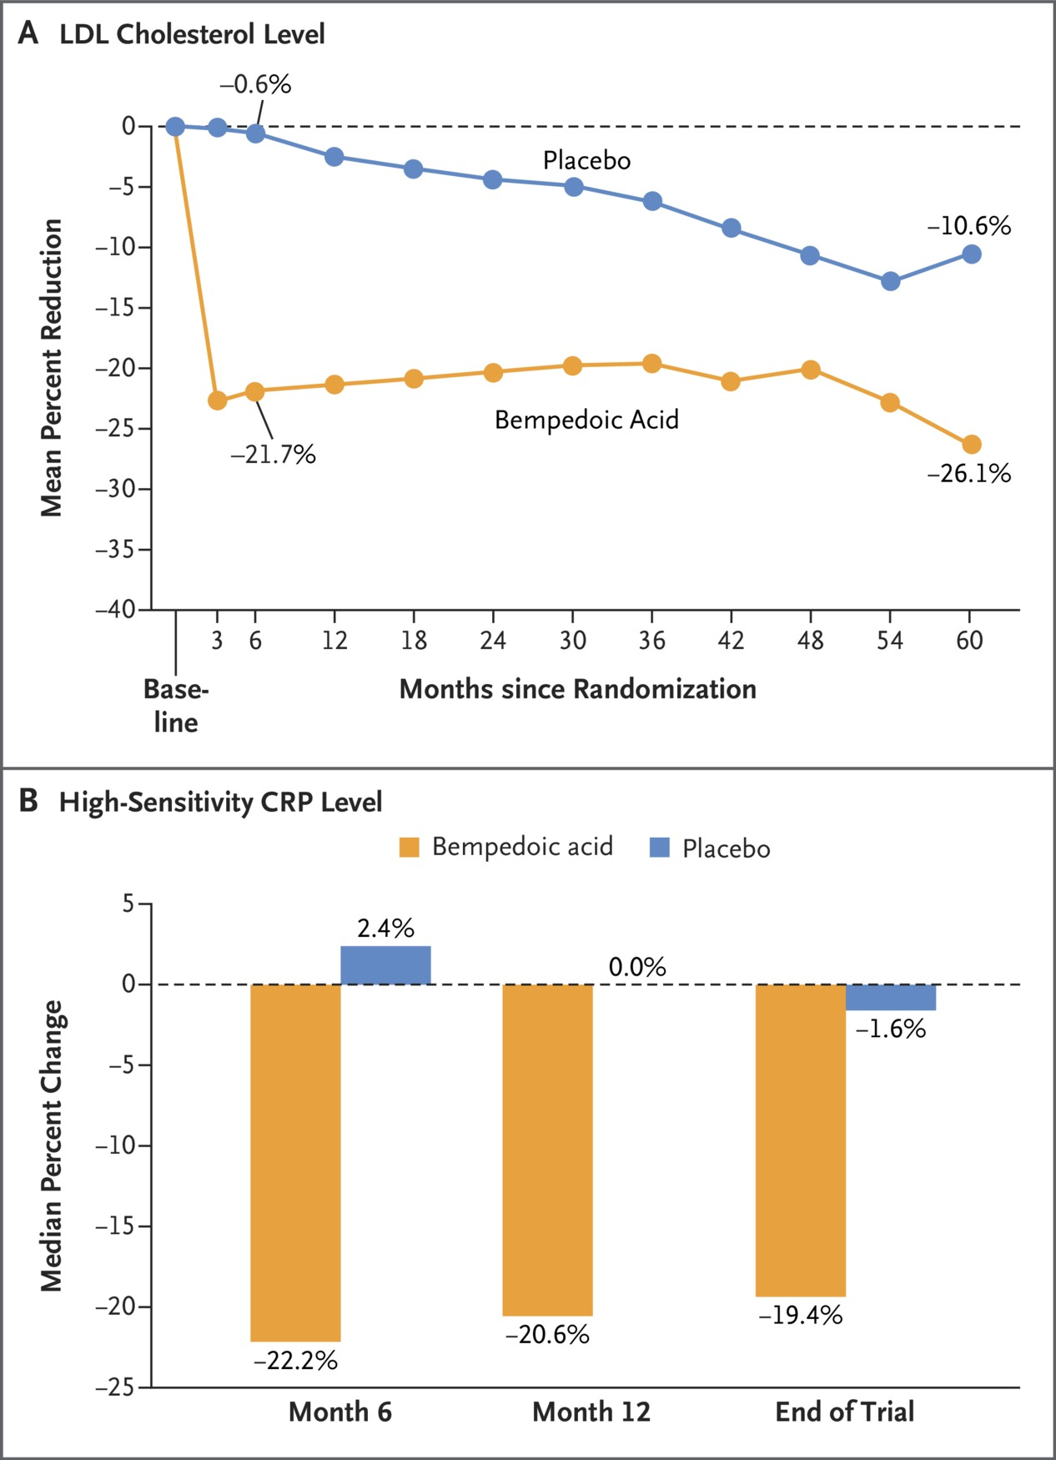
Changes in LDL Cholesterol and High-Sensitivity CRP Levels over Time.
Notes:
Figure 1 Changes in LDL Cholesterol and High-Sensitivity CRP Levels over Time. Panel A shows the percent changes from baseline in the low-density lipoprotein (LDL) cholesterol level in the bempedoic acid group and placebo group throughout the trial. The mean baseline LDL cholesterol level in both groups was 139.0 mg per deciliter. The time-averaged difference in the reduction in LDL cholesterol level between the bempedoic acid group and the placebo group over the duration of the trial was −22.0 mg per deciliter (−0.57 mmol per liter); the difference in percent reduction was 15.9 percentage points in favor of bempedoic acid. To convert the values for cholesterol to millimoles per liter, multiply by 0.02586. Panel B shows the changes from baseline in the high-sensitivity C-reactive protein (CRP) level in the bempedoic acid group and placebo group at several time points during the trial. The median baseline high-sensitivity CRP was 2.3 mg per liter.

Slide 56
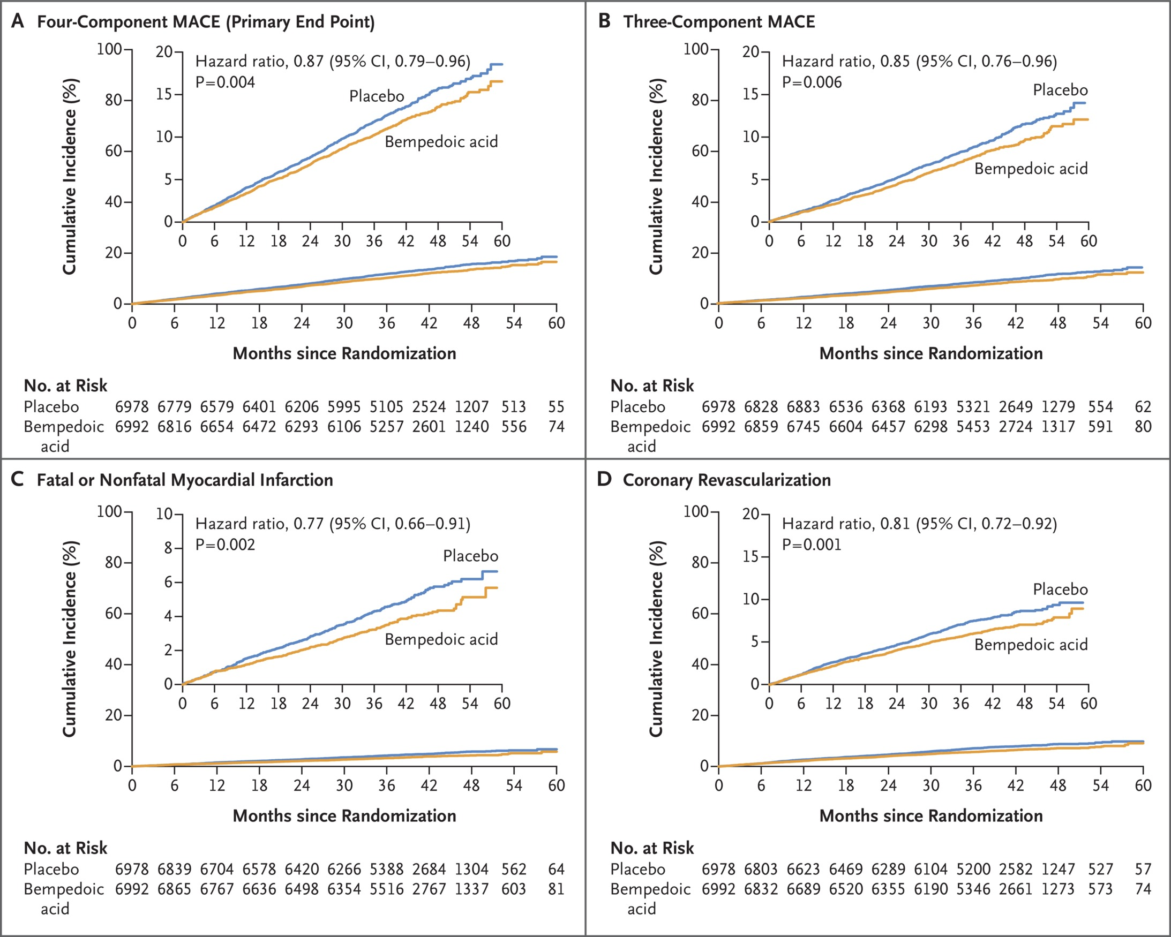
Cumulative Incidence of Cardiovascular Events.
Notes:
Figure 2 Cumulative Incidence of Cardiovascular Events. Panel A shows the cumulative incidence of a primary end-point event, a four-component composite of major adverse cardiovascular events (MACE), defined as death from cardiovascular causes, nonfatal myocardial infarction, nonfatal stroke, or coronary revascularization. Panel B shows the cumulative incidence of a three-component MACE, defined as death from cardiovascular causes, nonfatal myocardial infarction, or nonfatal stroke (the first key secondary end point). Panel C shows the cumulative incidence of fatal or nonfatal myocardial infarction (the second key secondary end point). Panel D shows the cumulative incidence of coronary revascularization (the third key secondary end point). The definitions of all end points are provided in the Supplementary Appendix. In each panel, the inset shows the same data on an enlarged y axis. The P values were calculated with the use of the log-rank test.

Slide 57
Conclusions
Among statin-intolerant patients, treatment with bempedoic acid was associated with a lower risk of major adverse cardiovascular events (death from cardiovascular causes, nonfatal myocardial infarction, nonfatal stroke, or coronary revascularization).

Slide 58
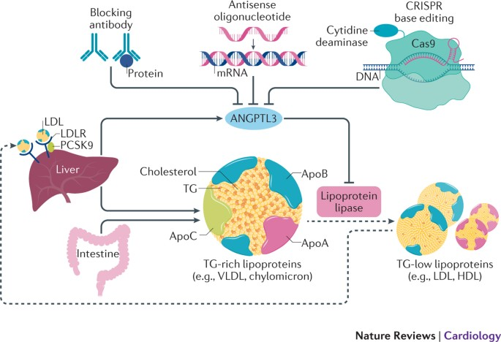
ANGPTL3 Targeting

Slide 59
Association of elevated plasma ANGPTL8 with various metabolic diseases.
Abu-Farha M, et al. Cardiovasc Diabetol. 2015 Aug 20;14:112.
Abu-Farha M, et al. Sci Rep. 2015 Jun 16;5:10949. doi: 10.1038/srep10949
Abu-Farha M, et al. PLoS One. 2016 Jan 19;11(1):e0147367.
Abu-Farha M, et al. Cardiovasc Diabetol. 2016 Feb 5;15:25.
Abu-Farha M, et al. Lipids Health Dis. 2016 Feb 11;15:26.
Abu-Farha M, et al. Lipids Health Dis. 2016 Oct 13;15(1):181.
Abu-Farha M, et al. Prog Lipid Res. 2020 Nov;80:101067.

Slide 60
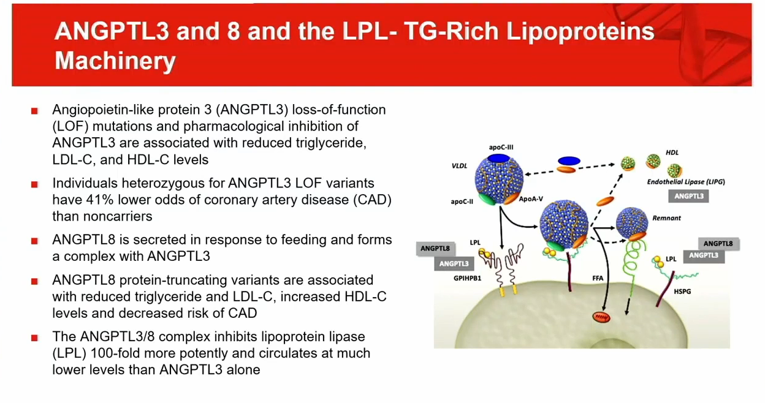

Slide 61
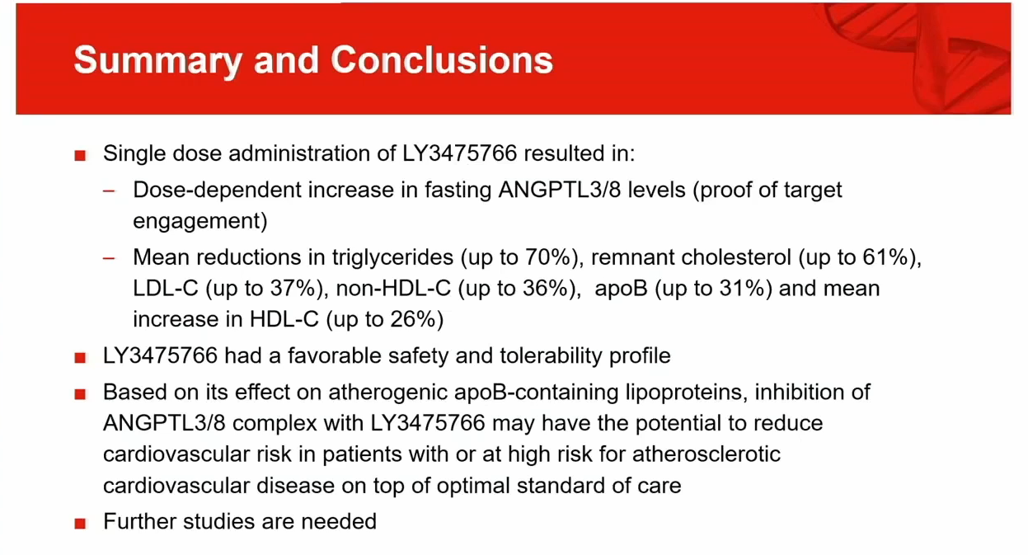

Slide 62
Highlights
Cardiovascular (CV) disease is the most common cause of death.
Lipid-lowering therapies continue to be under-used, and treatment goals often not achieved.
CV events that occur in patients, despite optimal risk factor control, are called “residual risk”. Lpa etc….
Lifestyle measures and the full and appropriate use of pharmacotherapies are needed to lower CV risk.
There is a need for simplified clinical recommendations, promotion of earlier lifestyle changes, and the use of combination therapies.

Slide 63
Thank You

Slide 64

A 38 Years old Person Blood Sample (OGTT)

Slide 65

Dasman Diabetes Institute, Kuwait
Thank You.

Slide 66

Take Home Message: Maybe we need to intervene even earlier

Slide 67
Inhibitors of PCSK9
Include: Evolocumab and alirocumab (100% human protein)
Mode of action:
Inhibit proprotein convertase subtilisin/kexin type 9 (PCSK9), a serine protease produced predominantly in the liver. It physiologically leads to the degradation of hepatocyte LDL-R and increased LDL-C levels.
TG and apo B-100 are reduced, & Lp(a) levels decrease by 25%
Reduce LDL-C up to 70% as monotherapy at the highest doses and up to 60% in patients already on statin therapy.
Reduced the risk of atherosclerotic events (MI, stroke) in patients with ASCVD when added to statins but did not reduce CVD death or mortality
Notes:
Development of inhibitors of proprotein convertase subtilisin/kexin type 9 (PCSK9) followed on the observation that loss of function mutations result in very low levels of LDL and no apparent morbidity.
physiological function of PCSK9 is acceleration of hepatic degradation of LDLR via direct binding and targeting the receptor to the lysosome. Loss of function mutations of PCSK9 are associated with reduced LDL and lowered risk of ASCVD. Conversely, mutations leading to increased PCSK9 expression result in increased LDL levels and higher risk of ASCVD events.It reduces LDL-C in a dose-dependent manner, by as much as 70 percent, and by as much as 60 percent in patients on statin therapy
treatment with PCSK9-abs appears to result in additional reductions in CV risk even in patients already on intensive or maximal statin therapy

Slide 68

Inhibitors of PCSK9
Notes:
PCSK9 accelerates hepatic degradation of LDL receptor via direct binding and targeting the receptor to lysosome.
Due to its pivotal role in LDL metabolism, inhibition of PCSK9 has emerged as a promising strategy to lower LDL-C. siRNAs and mAbs have been developed to block mRNA transcription and receptor binding activity of PCSK9.
In the presence of PCSK9, antibody to PCSK9, and a statin, levels of LDLR are increased by two different mechanisms. Statins, by inhibiting HMG/CoA reductase, reduce cell cholesterol, thereby activating sterol regulatory element–binding protein (SREBP) and upregulating transcription of genes under its control; those include genes for LDLR and PCSK9. Expression of LDLR and PCSK9 increases. respectively.

Slide 69
Inhibitors of PCSK9
Indication: (Not used during pregnancy)
Considered an adjunct agent in patients who do not meet cholesterol treatment goals despite maximal doses of statin, ezetimibe, and diet
Homozygous familial hypercholesterolemia (Only evolocumab/alirocumab)
Heterozygous familial hypercholesterolemia
Secondary prevention of cardiovascular events
Notes:
These fully humanized mAbs contain 100% human protein with no risk of immunogenicity, as opposed to chimeric and humanized mAbs, which contain 33% and 5–10% mouse sequences, respectively.
CNS SE: dizziness and fatigue
Currently, and because of cost effectiveness, treatment with maximally tolerated doses of statins and ezetimibe is recommended prior to initiation of PCKS9 inhibitors

Slide 70
Inhibitors of PCSK9
PK:
Given by SubQ injection once every 2 weeks or once monthly
t½ of PCSK9 elimination is 11-20 days, after which LDL levels begin to rise
Side Effects:
No risk of immunogenicity
Mainly injection site reactions (pain, erythemia)
Increased risk of infections such urinary and respiratory tract infection, and nasopharyngitis.
No effect on myopathy if combined with statins
Notes:
These fully humanized mAbs contain 100% human protein with no risk of immunogenicity, as opposed to chimeric and humanized mAbs, which contain 33% and 5–10% mouse sequences, respectively.
CNS SE: dizziness and fatigue
Currently, and because of cost effectiveness, treatment with maximally tolerated doses of statins and ezetimibe is recommended prior to initiation of PCKS9 inhibitors

Slide 71
siRNA Inhibitor of PCSK9
Inclisiran (Leqvio®) – small interference RNA against PCSK9
MOA: After rapid hepatic uptake, inclisiran binds to the PSCK9
mRNA in the liver to block PCSK9 protein synthesis
Reduces LDL-C by 52% in patients despite being on maximally tolerated statins when given every 6 months
Reductions in Lipoprotein(a) were also seen.
With inclisiran, 68% of patients achieved the target of LDL < 70 mg/dL compared to only 12.4% of those treated with statins
Notes:
Inclisiran is a long-acting, synthetic siRNA directed against proprotein convertase subtilisin-kexin type 9 (PCSK9), conjugated to triantennary N-acetylgalactosamine carbohydrates, which bind to abundant liver-expressed asialoglycoprotein receptors, leading to a rapid uptake of inclisiran specifically into hepatocytes. Inclisiran engages the natural pathway of RNA interference (RNAi) by binding to the RNA-induced silencing complex (RISC) intracellularly, enabling it to catalytically cleave PCSK9 messenger RNA (mRNA), which itself is then degraded, inhibiting translation into PCSK9. With less PCSK9 available, more low-density lipoprotein-cholesterol (LDL-C) receptors can be recycled to the hepatic membrane for LDL-C uptake

Slide 72

MOA of Inclisiran
Notes:
These fully humanized mAbs contain 100% human protein with no risk of immunogenicity, as opposed to chimeric and humanized mAbs, which contain 33% and 5–10% mouse sequences, respectively.
CNS SE: dizziness and fatigue
Currently, and because of cost effectiveness, treatment with maximally tolerated doses of statins and ezetimibe is recommended prior to initiation of PCKS9 inhibitors

Slide 73
siRNA Inhibitor of PCSK9
Indication:
Primary hypercholesterolemia or combined dyslipidemia as an adjunct to diet in patients not reaching recommended LDL levels:
  In combination with maximally tolerated statins
  As monotherapy or combination with other lipid lowering drugs in those intolerant/contraindicated to statins
PK:
Given by SubQ 300 mg injection initially, then 3 months later, then every 6 months thereafter
Side Effects:
Mainly injection site adverse reactions (erythema, pain, or rash)
Notes:
These fully humanized mAbs contain 100% human protein with no risk of immunogenicity, as opposed to chimeric and humanized mAbs, which contain 33% and 5–10% mouse sequences, respectively.
CNS SE: dizziness and fatigue
Currently, and because of cost effectiveness, treatment with maximally tolerated doses of statins and ezetimibe is recommended prior to initiation of PCKS9 inhibitors

Slide 74
Bempedoic Acid
Mode of action:
Inhibits adenosine triphosphate (ATP) citrate lyase, an enzyme upstream of 3-hydroxy-3methylglutarly-CoA reductase leading to decreased cholesterol synthesis and increased LDL-R
When used in patients on maximally tolerated doses of statins, it reduced LDL-C by an additional 17%
Indication:
as an adjunct to diet and maximally tolerated doses of statins in patients who require additional lowering of LDL-C in:
Heterozygous familial hypercholesterolemia or
Established atherosclerotic cardiovascular disease
PK: Orally 180 mg OD

Slide 76
Bempedoic Acid
SEs and caution:
Hyperuricemia and gout (dose related) - common
  Occur within the first 4 weeks of treatment and may persist
  Risk higher in patients with prior history of gout
  Measure serum uric acid and stabilize patients with active gout before starting bempedoic acid
Leukopenia, back pain, abdominal pain - occasionally
Tendon rupture or injury – rarely
Notes:
Dose-related; related to the pharmacologic action; inhibition of tubular OAT2 may increase blood uric acid levels.

Slide 77


Slide 78
Lomitapide
Mode of action:
Inhibits microsomal triglyceride transfer protein resulting in less VLDL and chylomicron secretion to bloodstream leading to a reduction in plasma LDL-C, TC, apo-B and non-HDL lipoproteins.
Reduces LDL-C by up to 50%
Indication:
Homozygous familial hypercholesterolemia as an adjunct to diet and maximal tolerated doses of statins
PK: Orally OD without food or 2 hours after an evening meal
SEs and caution: (Not used during pregnancy)
Diarrhea, abdominal pain, & vomiting. May elevate ALT or AST
Patients should maintain a low-fat diet to avoid steatorrhea
Notes:
first-in-class lipid-lowering medication for patients with Homozygous FH.
there is a risk of hepatotoxicity associated with the use of Juxtapid. Juxtapid can cause elevations in transaminases. Juxtapid also increases hepatic fat
is indicated as an adjunct to a low-fat diet and other LLD to reduce LDL-C, TC, apo B, and non-HDL-C in patients with Homoz FH.
increases hepatic fat, with or without concomitant increases in transaminases.
Lomitapide is administered with water and without food (or at least 2 h after the evening meal) because administration with food may increase risk of GI adverse effects.

Slide 79

Lomitapide
Notes:
MTP is an endosomal protein present in hepatocytes and intestinal enterocytes. It catalyzes the assembly of cholesterol, triglycerides, and apo B to VLDL or chylomicrons. Normal concentrations and function of MTP are necessary in the liver and intestine for the proper assembly and secretion of lipoproteins that contain apoB. MTP is responsible for transferring TG onto apo-B in the assembly of VLDL, the precursor to LDL.
If insufficient lipid is transferred, the emerging apo-B is destroyed, and lipoprotein secretion is inhibited. Inhibition of MTP activity prevents both hepatic VLDL and intestinal chylomicron secretion, and consequently lowers plasma lipids. This means that compounds that inhibit MTP may have the ability to profoundly reduce serum levels of both cholesterol and TG.
The risk associated with MTP inhibition is accumulation of triglycerides in the liver. This concept is supported by findings in patients with familial hypobetalipoproteinemia (FHBL). FHBL is an inherited disorder caused by truncations of the apo B protein that cannot be secreted by the liver. Patients with FHBL have an increased risk for developing hepatic steatosis; nevertheless, they seem to be protected against atherosclerotic disease

Slide 80

Mipomersen
Mode of action:
Is an antisense oligonucleotide
targeting apo B-100 mRNA to
reduce apo B-100 liver expression
Reduces LDL levels by 30-50%
and reduces apo-B, and Lp(a)
Indication:
Homozygous familial hypercholesterolemia
PK: Given by SubQ injection once weekly and distributes mainly to the kidney and liver
Side Effects: Injection site reactions, flu-like symptoms & headache
Notes:
Mipomersen is an antisense oligonucleotide complementary to the coding region for human apo B mRNA. Apo B is the major structural component of LDL, VLDL and IDL particles.
ApoB100 is selectively synthesized in the liver and synthesis of apoB48 in the intestine is unaffected by ASO.
In 2 trials mipomersen decreased LDL-C by 25-28% in patients with Homoz or Heterzy FH.
Maximum LDL reduction seen after ~ 6 months. It reduces LDL, TC, Apo-B and non HDL-C
Common SEs: injection site reactions (~80%), flu-like symptoms (~30%), and persistent increases in serum ALT levels ≥ 3 times the upper limit of normal (~10%).
Mipomersen binds to the mRNA coding for ApoB-100, a protein that is the main component of LDL and VLDL. As a consequence, the RNA is degraded by the enzyme ribonuclease H, and ApoB-100 is not translated
LDL levels are reduced 30% to 50% with this treatment, although the discontinuation rates were high in clinical trials with this drug. The t1/2 is 1 to 2 months. Maximal LDL reduction occurs after 6 months of
treatment. Use is contraindicated in individuals with liver disease.

Slide 81
Evinacumab (ANGPTL3 Inhibitor)
Mode of action (mAB):
Binds angiopoietin-like protein 3 (ANGPTL3) to inhibit its function
ANGPTL3 is a liver protein that inhibits both lipoprotein lipase and endothelial lipase and has been shown to increase atherosclerosis and CAD in patients with gain of function of ANGPTL3
Reduced LDL-C by 47% when given to homozygous familial hypercholesterolemia patients already on lipid lowering drugs
Both TG and HDL were also significantly reduced
Indication:
Homozygous familial hypercholesterolemia
PK: Given as 15 mg/kg IV infusion over 60 min every 4 weeks
Side Effects: Flu-like symptoms and increased risk of infections

Slide 82

MOA of Evinacumab
Notes:
ANGPTL3 inhibits both the lipoprotein and endothelial lipases and thus the conversion of VLDL into LDL. A similar effect is determined by ANGPTL4 and apoC-III, while apoC-II is a coactivator of lipoprotein lipase. The monoclonal antibody evinacumab binds and inhibits the ANGPTL3 generating VLDL remnant particles that are efficiently removed from the circulation. Thus, ANGPTL3 inhibition may lower LDL-C by limiting LDL particle production and endothelial lipase could be a key mediator of this novel pathway.

Slide 83
ANGPTL3 Targeting

Slide 84
ANGPTL3 Targeting

Slide 85
Volanesorsen (APOC3 Inhibitor)
Mode of action:
Is an antisense oligonucleotide inhibitor of APOC3 angiopoietin-like protein 3 (ANGPTL3) to inhibit its function
Reduced APOC3 levels by 84% and TG levels by 77% in patients deficient in lipoprotein lipase activity
Indication:
Familial Chylomicronemia Syndrome
PK: Given as 300 mg subcutaneously once a week
Side Effects: Injection site reactions and thrombocytopenia
Notes:
Familial chylomicronemia syndrome (FCS) is a rare genetic disorder estimated to affect 1-2 individuals per million. It is a serious disease that prevents the body from breaking down fats consumed through the diet, or TG. Chylomicrons help move triglycerides to different parts of the body where they are needed for energy and fat storage.
While several genetic causes have been associated with FCS, about 80% of people with FCS have a problem with lipoprotein lipase. ith FCS, it is not uncommon for triglyceride levels to exceed 1,000 mg/dL, even after medications and/or a low-fat diet are introduced.
The development of N-acetyl-galactosamine antisense oligonucleotide conjugates for delivery to the liver may provide a means to avoid the thrombocytopenic risk
Thrombocytes returned to normal on cessation of the agent

Slide 86
Omega-3 Fatty Acids
The active components of fish oils are eicosapentaenoic acid (EPA) and docosahexaenoic acid (DHA).
Both increase LP lipase activity, lower TG & VLDL synthesis, and increase HDL. LDL may increase at higher doses (At 3-4 g/day)
Cardioprotective effects (At 1 g/day):
  Reduce platelet aggregation
  Decrease BP and inflammation
  Reduce arrhythmias
  Improve EC function
Notes:
Active omega-3 fatty acids constitute only 30 to 50 percent of many fish oil supplements. AHA recommends patients with CHD consume 1 g of EPA and DHA per day (preferably from diet) for potential cardiovascular benefits. LDL-C can increase with higher doses, secondary to a shift to larger, less atherogenic particles. It can lower the serum TG by as much as 50 %. However, their use is often limited by metabolic and GI side effects. Effect is inconsistent and significant increases in LDL have been reported with the use of fish oils.

Slide 87
Omega-3 Fatty Acids
Four omega-3 FA products are approved for treatment of high TG ≥ 500 mg/dL in adults:
  Omega-3 carboxylic acid (Epanova)
  Omega-3-acid ethyl esters (Lovaza, Omtryg)
  Icosapent ethyl (Vascepa)
Side Effects and caution:
Dyspepsia, taste changes, and GI disturbances
May increase risk of infection at high doses
Monitoring: LDL-C and ALT tests (may increase occasionally)
Notes:
Fish oil supplements are well tolerated even at higher doses. Dose-dependent belching, dyspepsia, taste changes, & GI disturbances are most common adverse effects (5-20% of pts)
High doses may increase infection risk due to suppression of T- and B-cell function
2015 FDA approval: Epanova: Each 1 g capsule contains at least 850 mg of polyunsaturated fatty acids, including multiple omega-3 fatty acids (EPA and DHA being the most abundant).
2012 FDA approval: Icosapent ethyl (Vascepa): Tx of high TG

